Slide 1

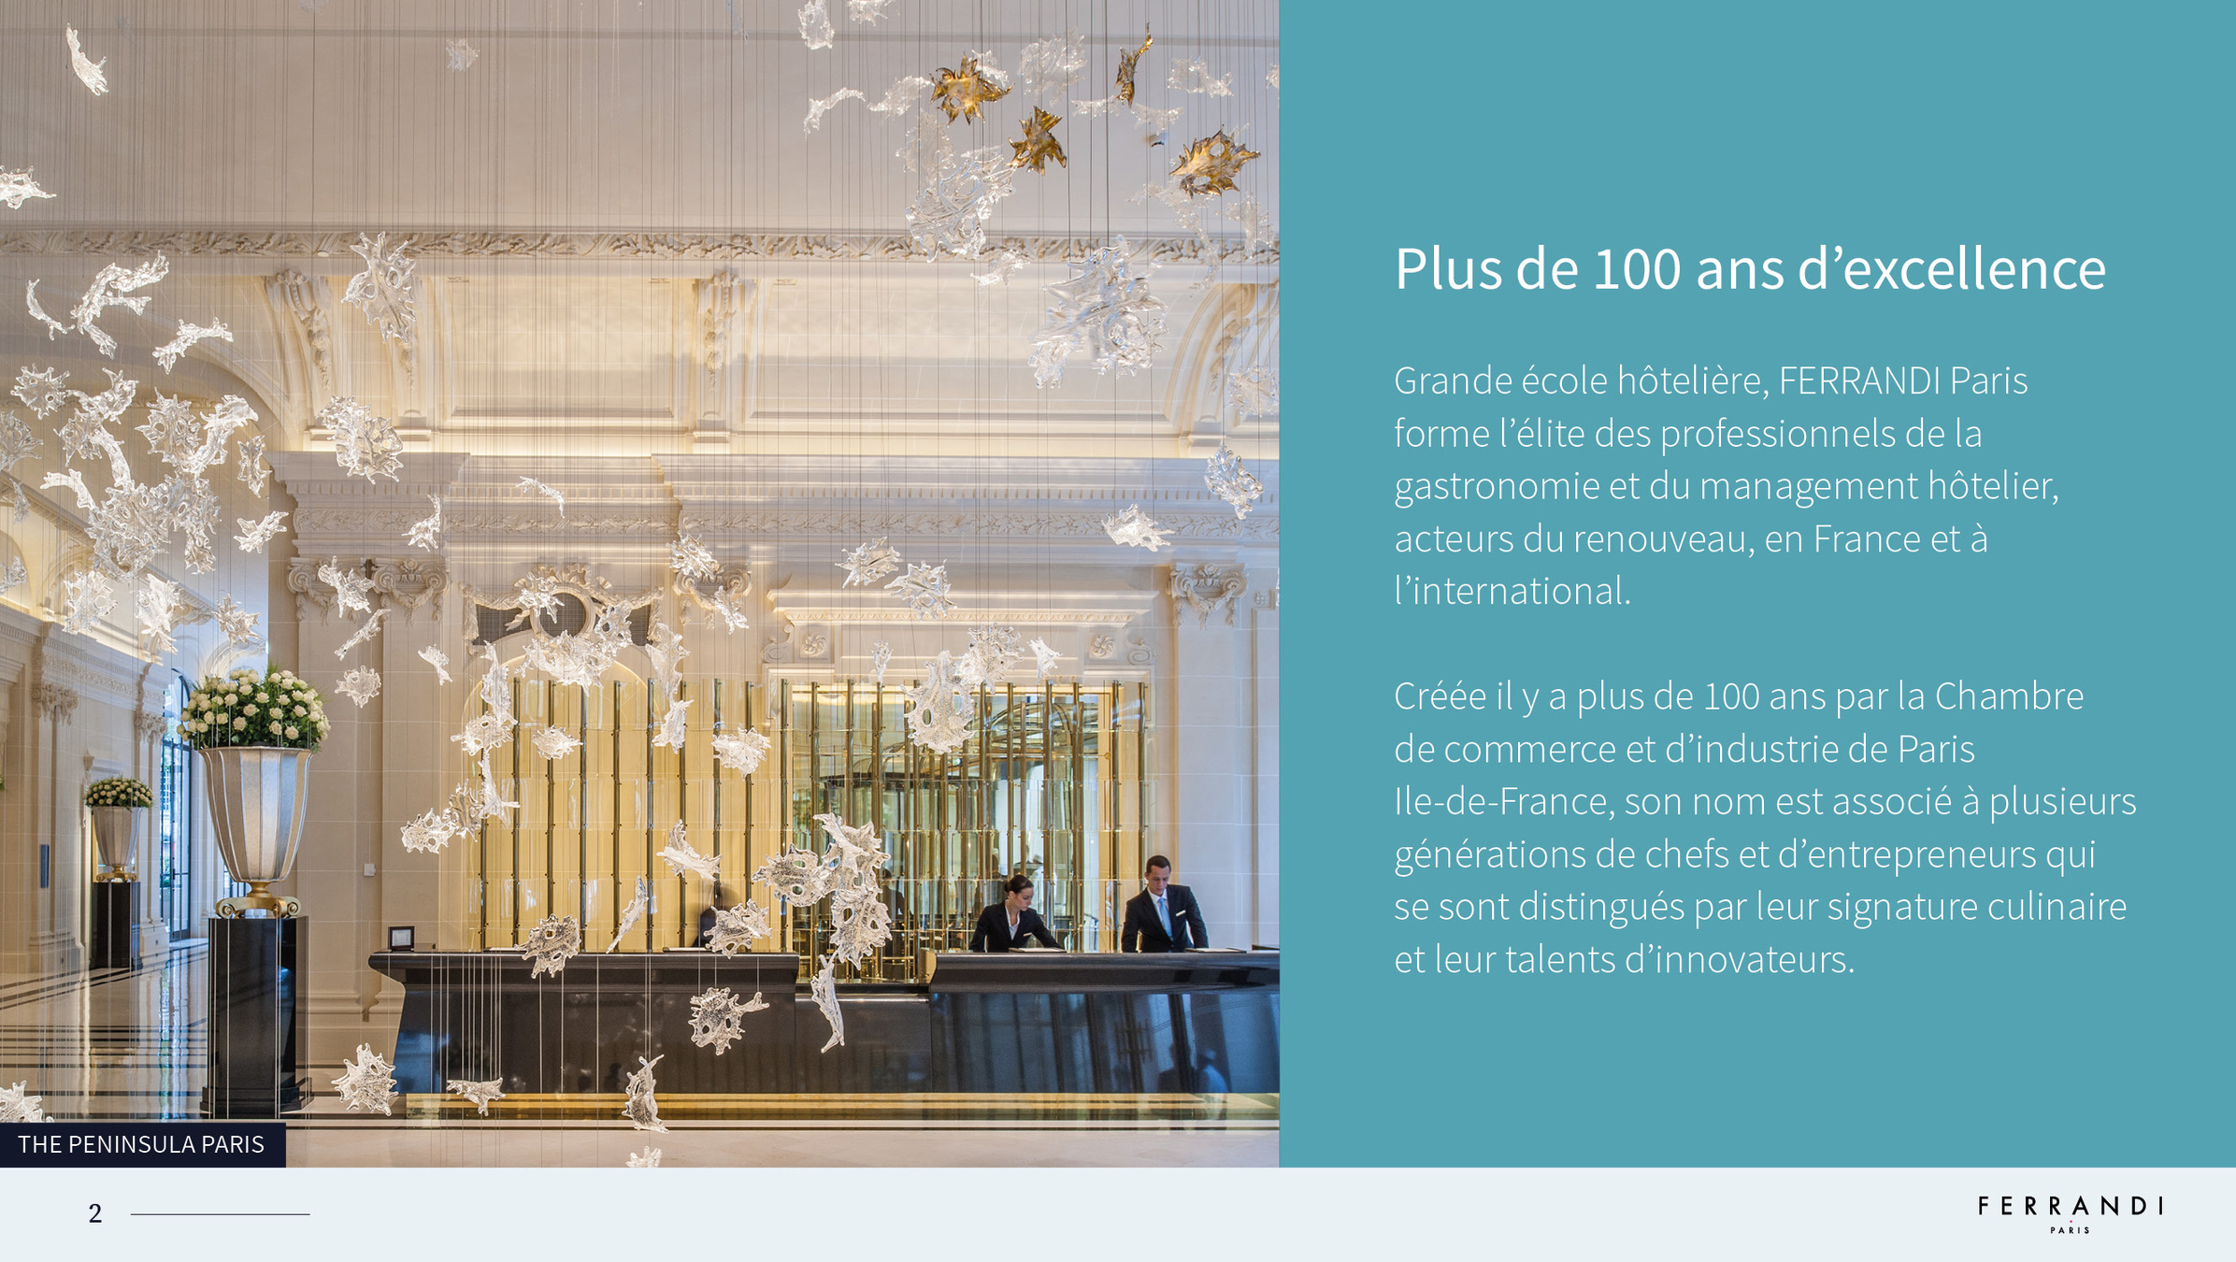
FERRANDI PARIS – RENNES CAMPUS

Slide 2
Over 100 years’experience in promoting excellence
As a CGE member, FERRANDI Paris trains elite professionals in gastronomy and hospitality management, advancing these fields in France and internationally.
Established over 100 years ago by the Paris Île-de-France Chamber of Commerce, it has a legacy of chefs and entrepreneurs known for their culinary skill and innovation.

Slide 3

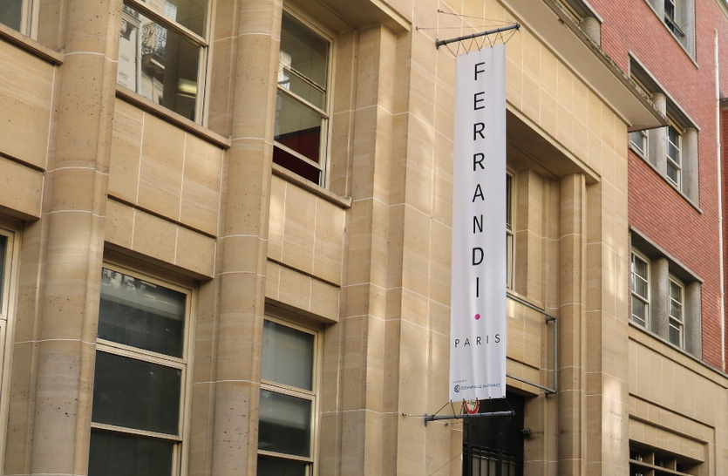



The French school of Gastronomy and Hospitality Management
FERRANDI Paris: Culinary and Hospitality Excellence
Established in 1920 by the Paris Île-de-France Chamber of Commerce, FERRANDI Paris stands out as the only "Grande École" offering diplomas from CAP to master's level, shaping future leaders in gastronomy and hospitality.
Bachelor’s degree recognized by the Ministry of Higher Education, Research and Innovation

Slide 4
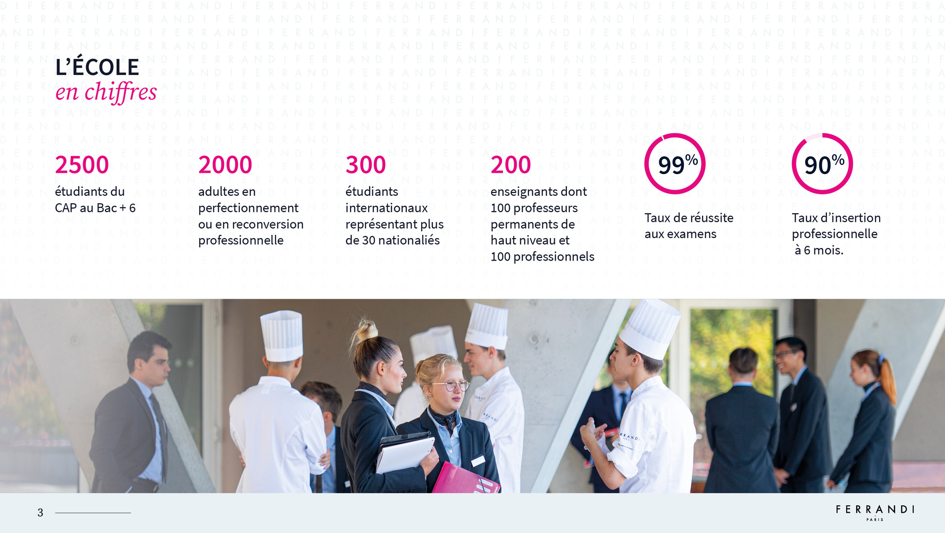
THE SCHOOL
in numbers
Students from vocational qualifications to post-master’s degrees
Adults improving their skills or changing careers
International students from 30 different countries
Instructors, including 100 top-level permanent instructors and 100 professionals
Sucess rate in final exams
Employement rate within six months of graduation

Slide 5
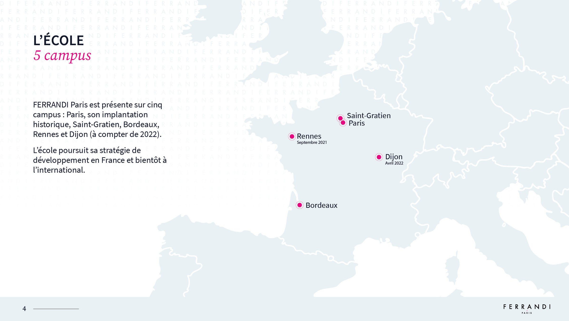
THE SCHOOL
6 campus
FERRANDI Paris has five campuses: its historic location in Paris, as well as in Saint-Gratien, Bordeaux, Rennes, Strasbourg, and Dijon.
The school is pursuing a development strategy in France and aims to expand internationally.
Strasbourg

Slide 6
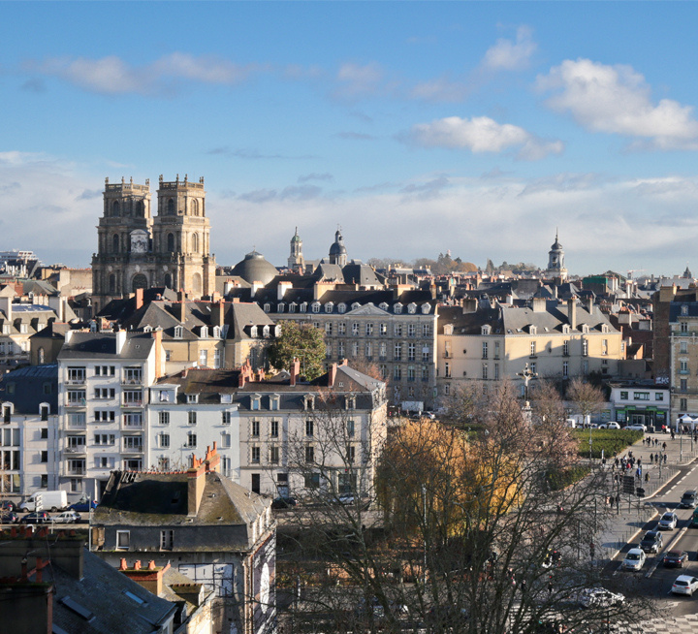
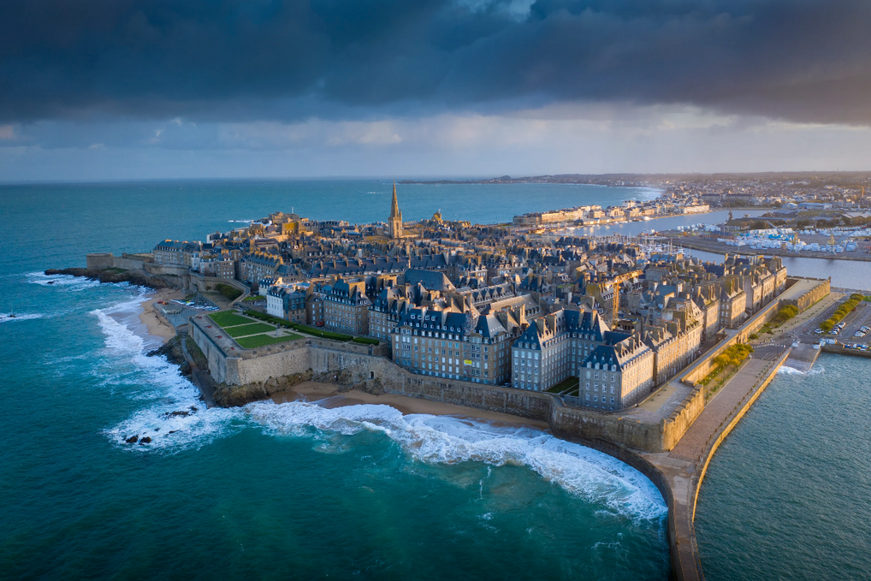
Rennes and its surroundings
France’s second-best student city
A region that proudly claims its culinary heritage
Ideally located https://www.tourisme-rennes.com/
Rennes
St-Malo
Notes:
7

Slide 7

THE SCHOOL
Our missions
Train the future key players of modernization
Gastronomy and hospitality
Develop an educational approach and mindset
Promote culinary knowledge and wisdom
The French way, in France and
abroad
Hard work, curiosity, innovation and generosity

Slide 8
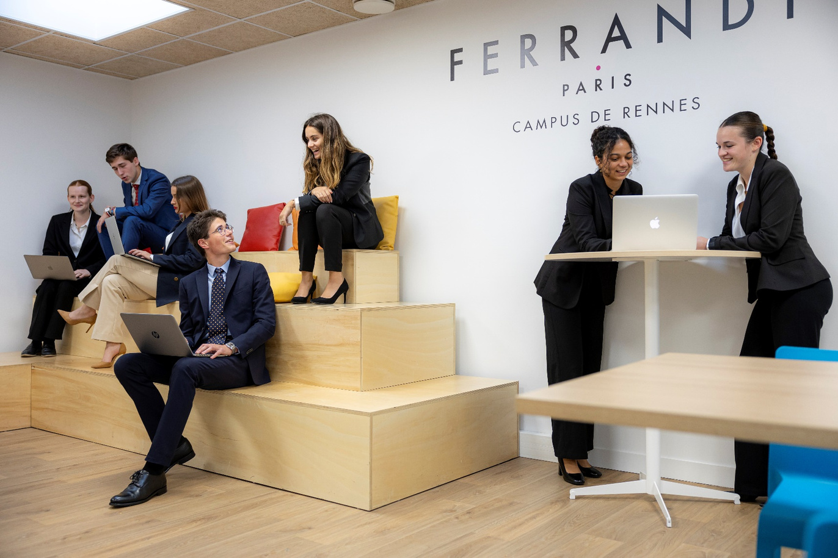
FERRANDI Paris – Rennes
Small and friendly (2500m2)
4 kitchens (cookery and bakery)
1 training restaurant : l’Hermine
1 training shop
1 coworking space
2 break rooms for students
premises
Notes:
8

Slide 9
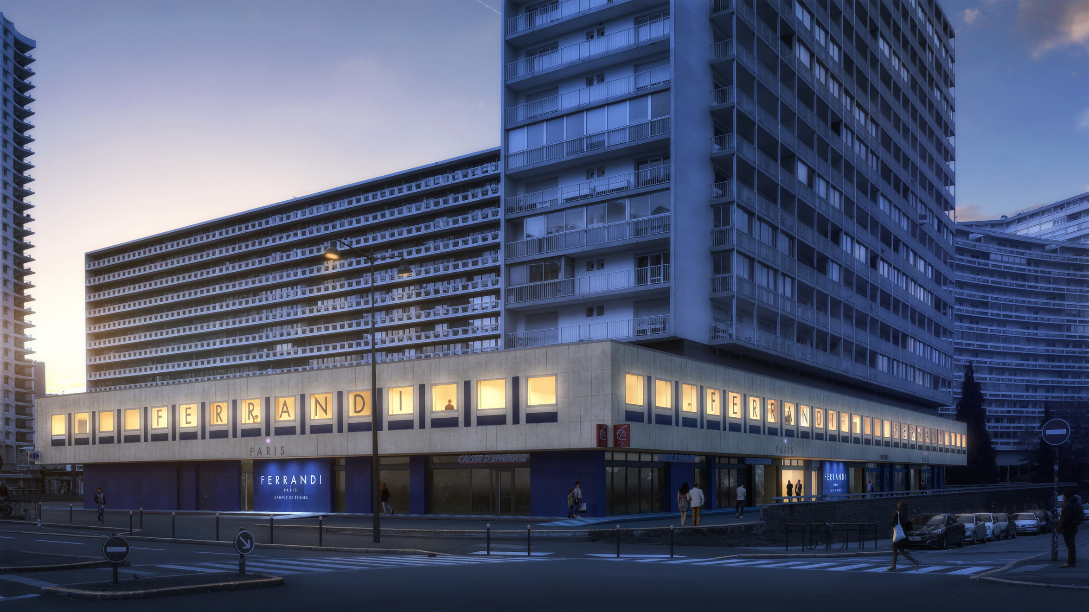
L’école FERRANDI Paris - Campus de Rennes
Le Bachelor Arts Culinaires et Entrepreneuriat option Cuisine ou Pâtisserie
Le Bachelor Management Hôtelier et Restauration

Slide 10
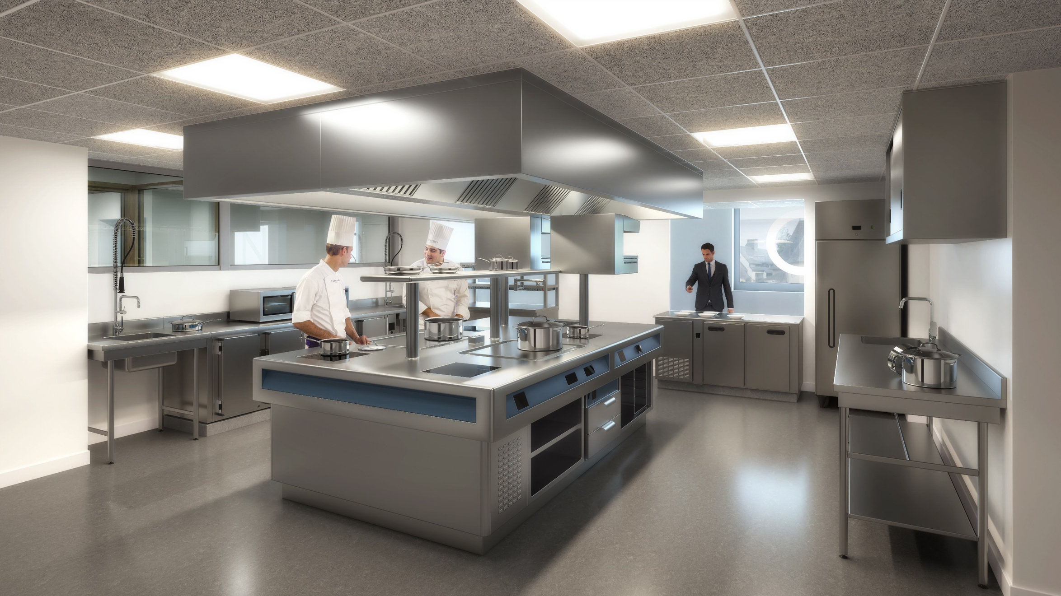
L’école FERRANDI Paris - Campus de Rennes
Le Bachelor Arts Culinaires et Entrepreneuriat option Cuisine ou Pâtisserie
Le Bachelor Management Hôtelier et Restauration

Slide 11
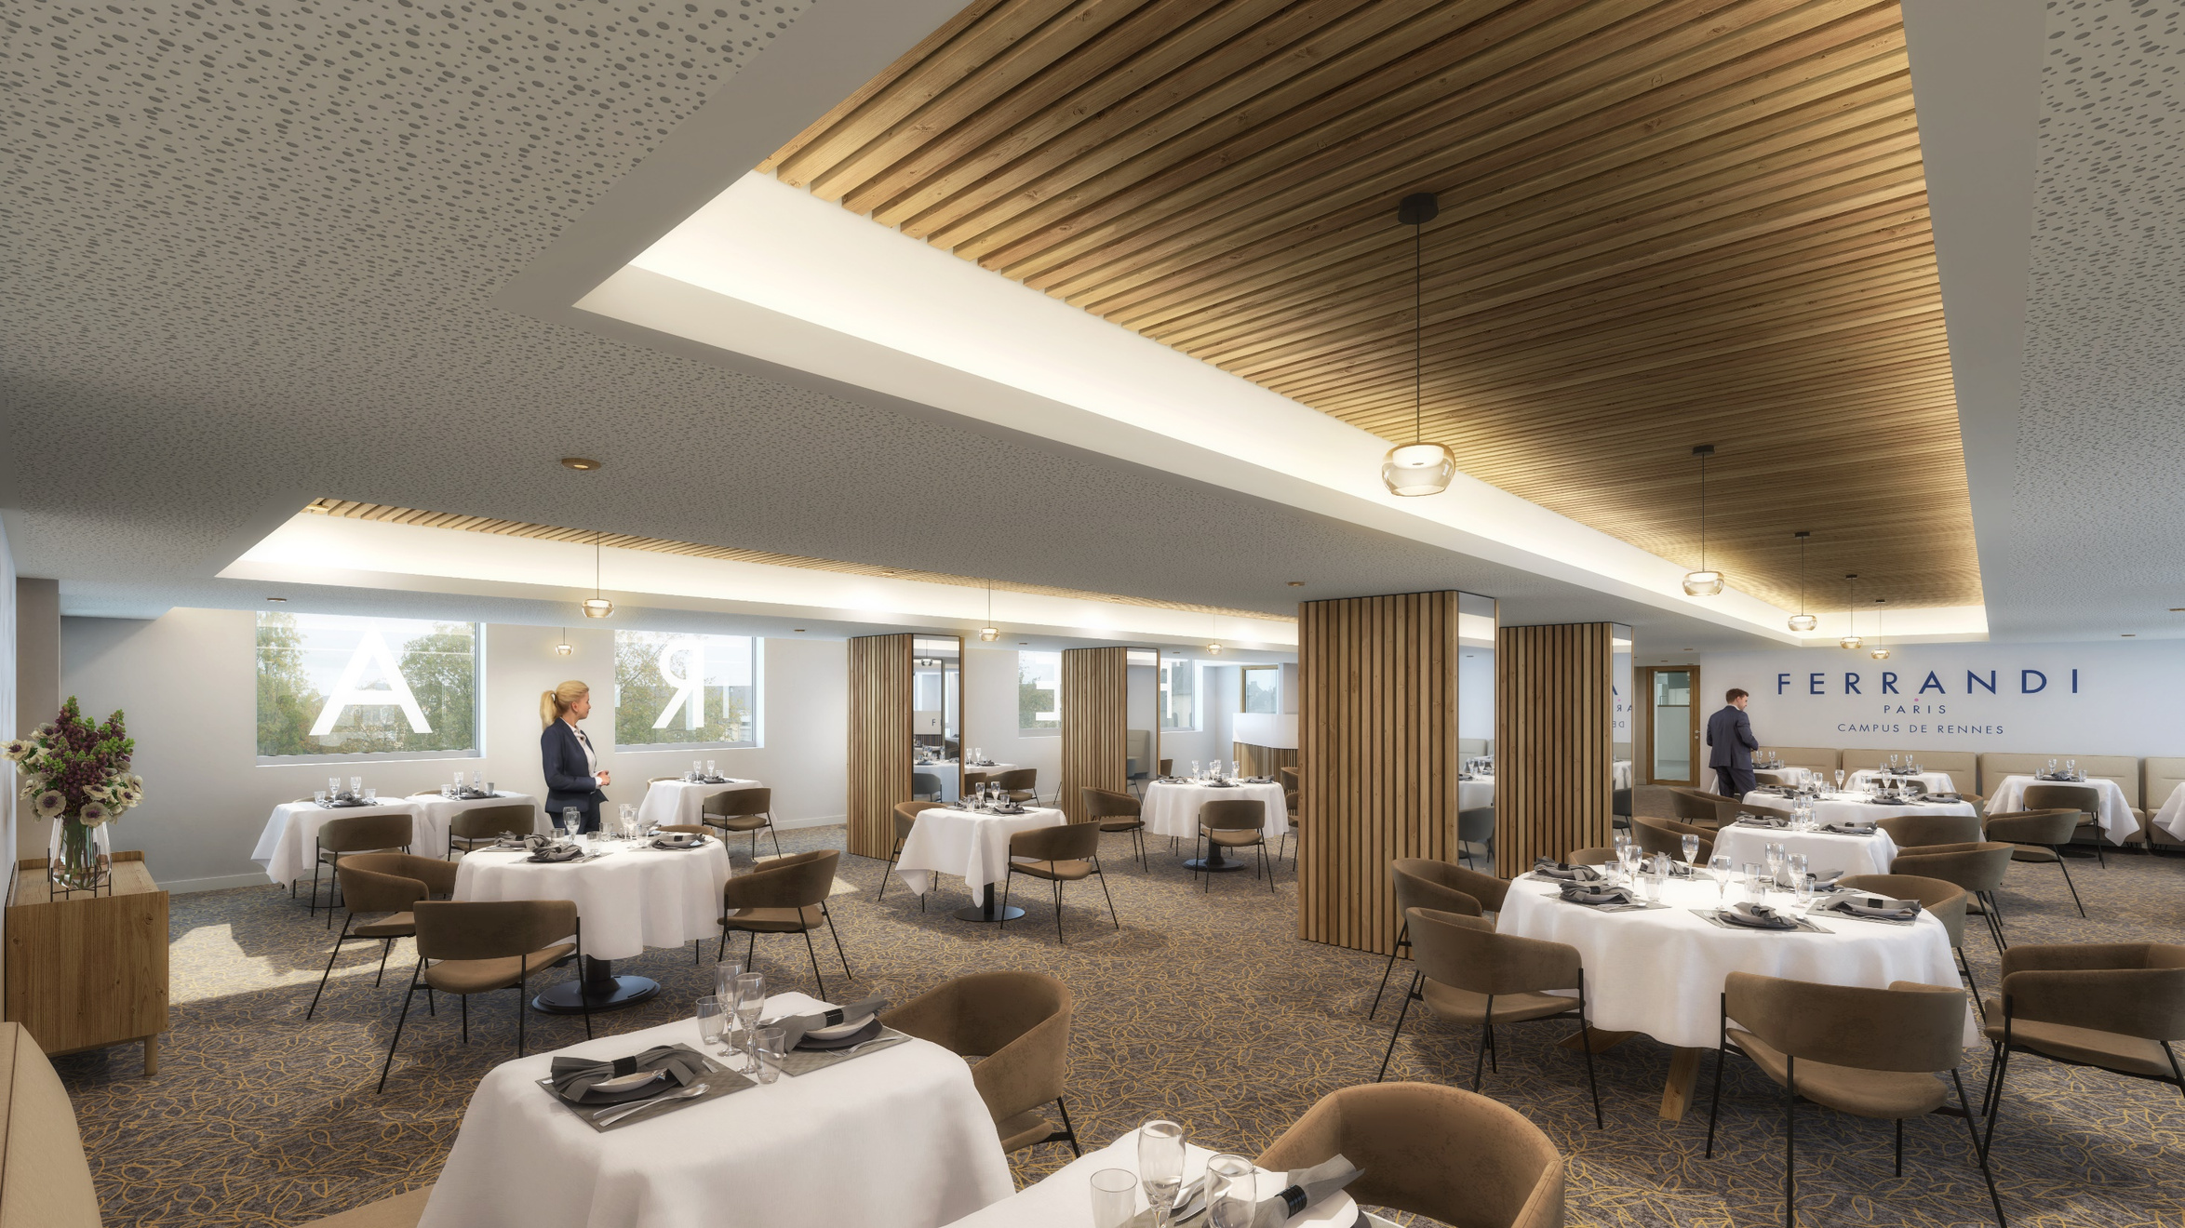
L’école FERRANDI Paris - Campus de Rennes
Le Bachelor Arts Culinaires et Entrepreneuriat option Cuisine ou Pâtisserie
Le Bachelor Management Hôtelier et Restauration

Slide 12
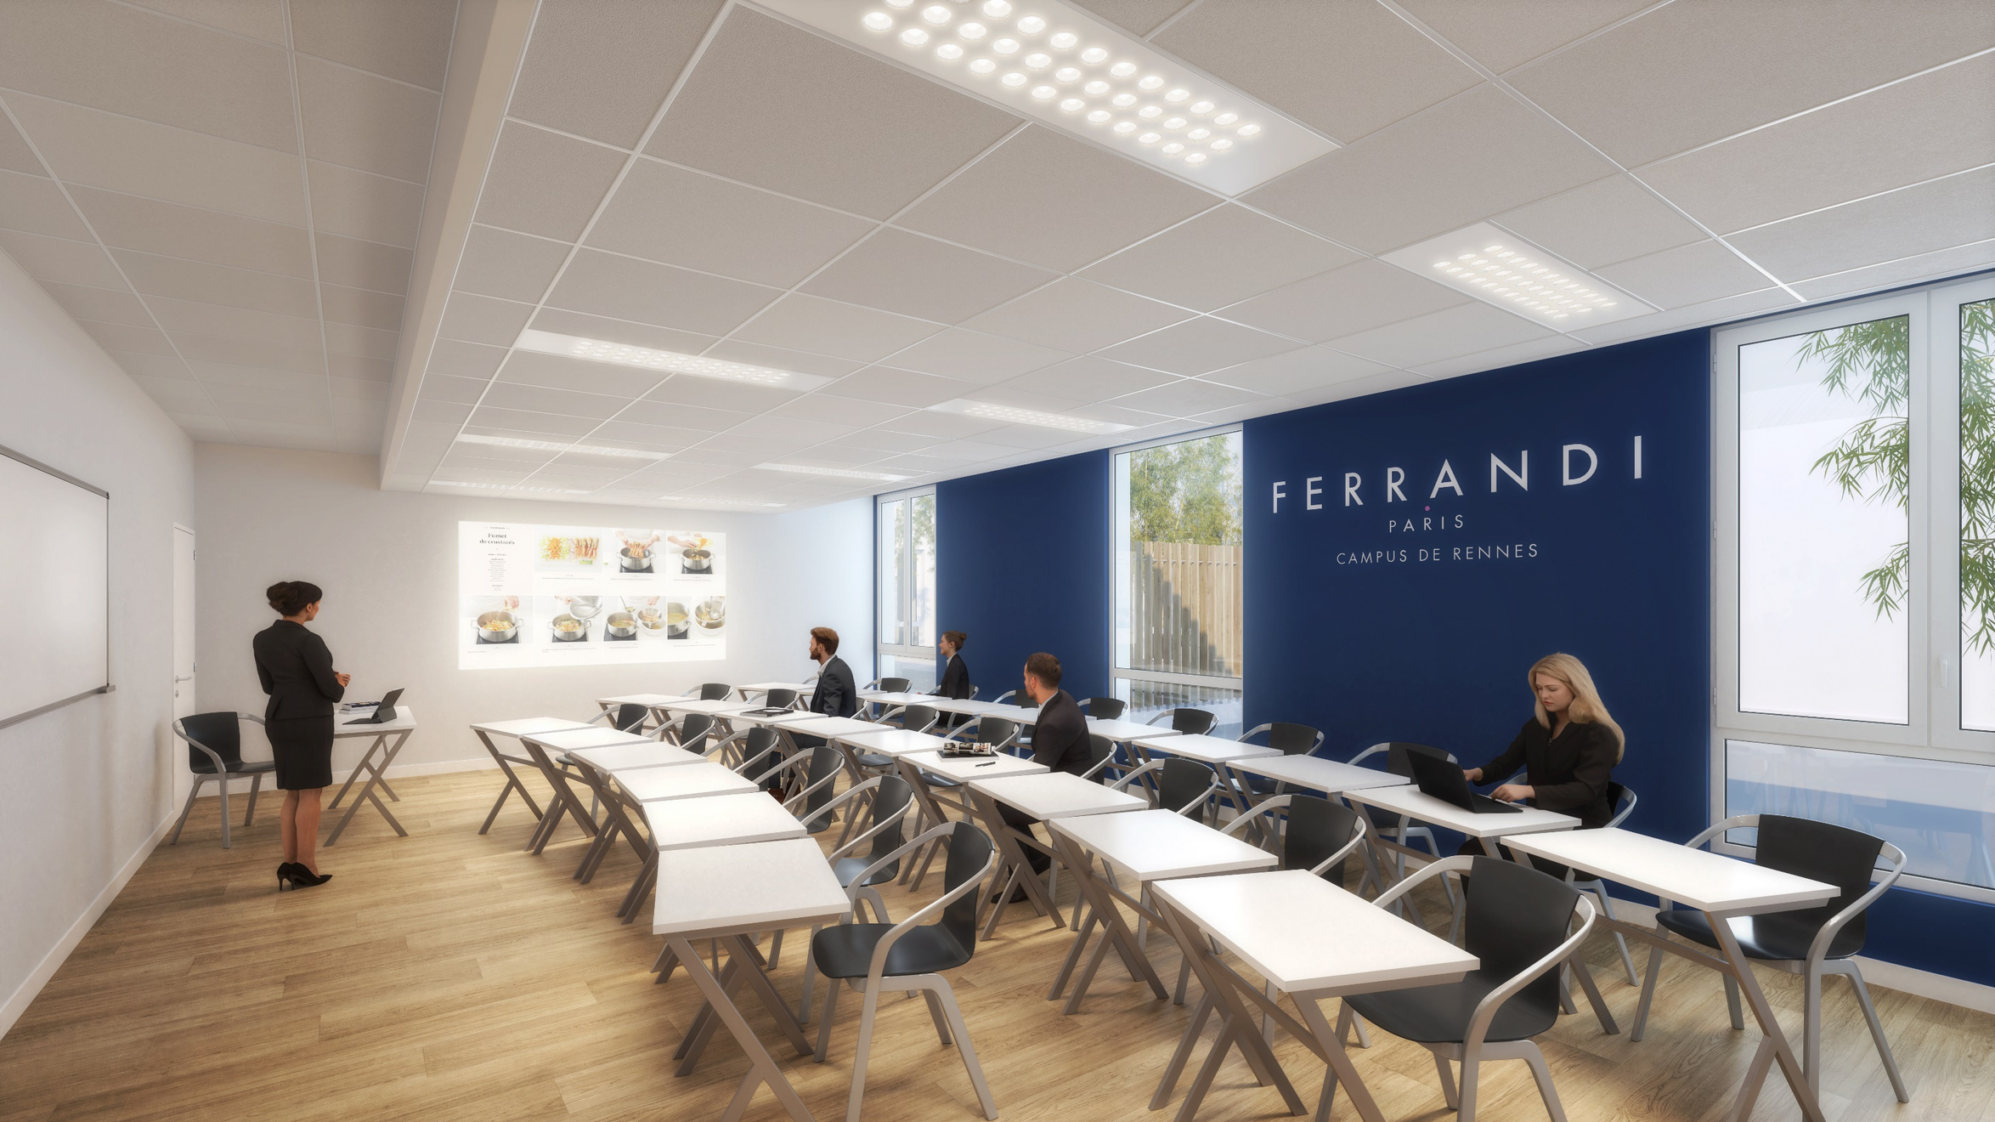
L’école FERRANDI Paris - Campus de Rennes
Le Bachelor Arts Culinaires et Entrepreneuriat option Cuisine ou Pâtisserie
Le Bachelor Management Hôtelier et Restauration

Slide 13
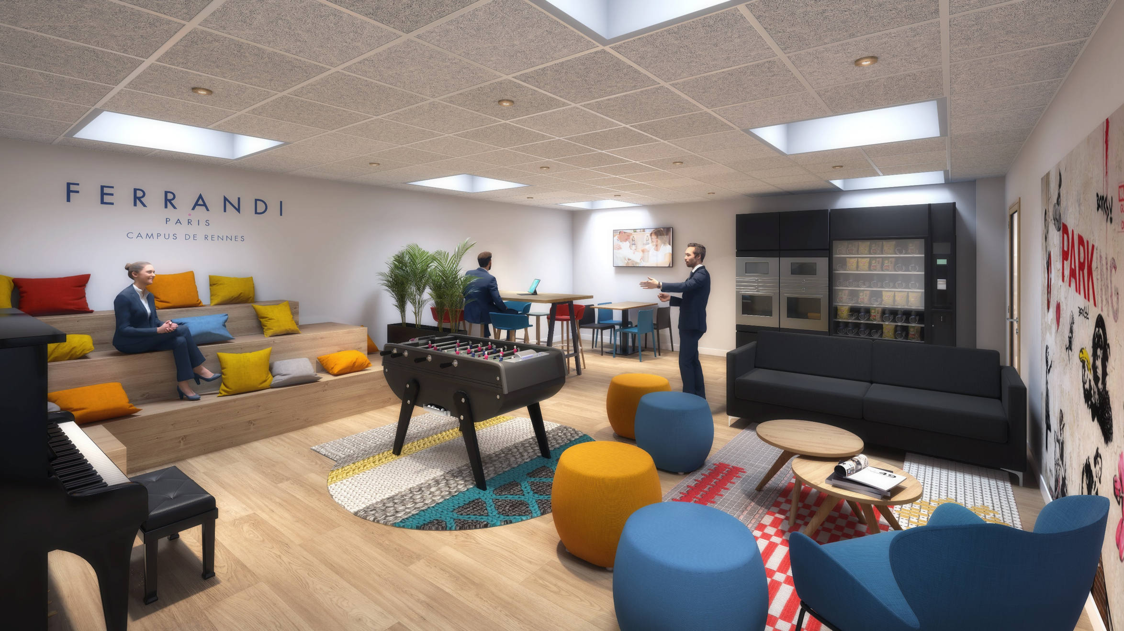
L’école FERRANDI Paris - Campus de Rennes
Le Bachelor Arts Culinaires et Entrepreneuriat option Cuisine ou Pâtisserie
Le Bachelor Management Hôtelier et Restauration

Slide 14

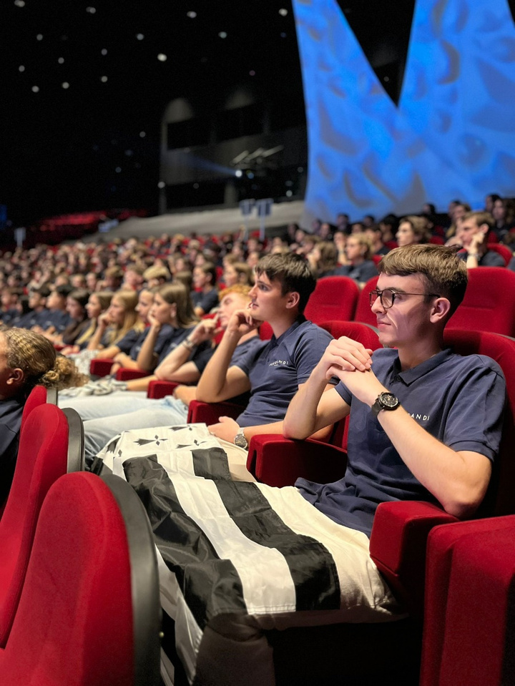
Student Life
Co-working spaces
Cafeteria
Student associations
Events
Student housing assistance
Notes:
16

Slide 15

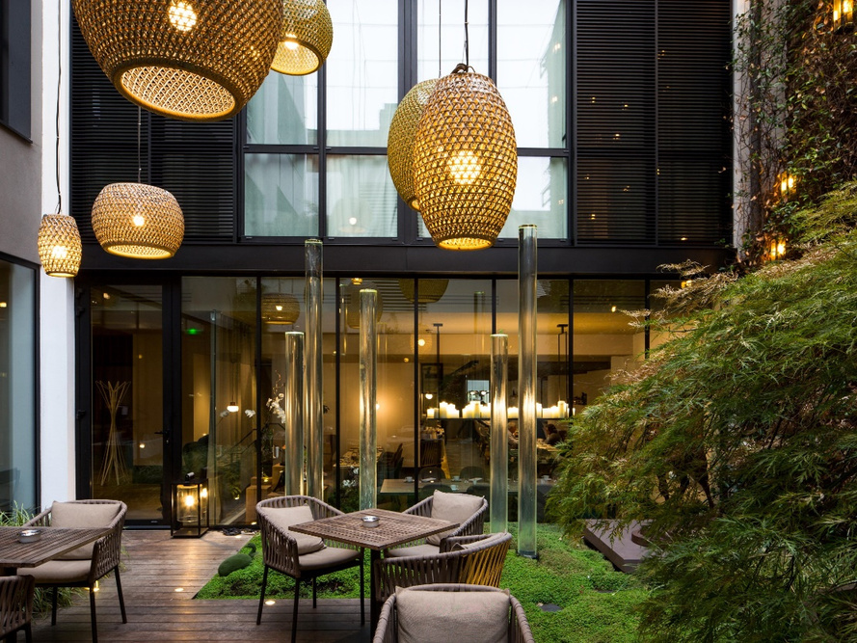

Exclusive Partnership
An educational partnership with the five-star Le Balthazar Hotel and Spa.
Notes:
14

Slide 16
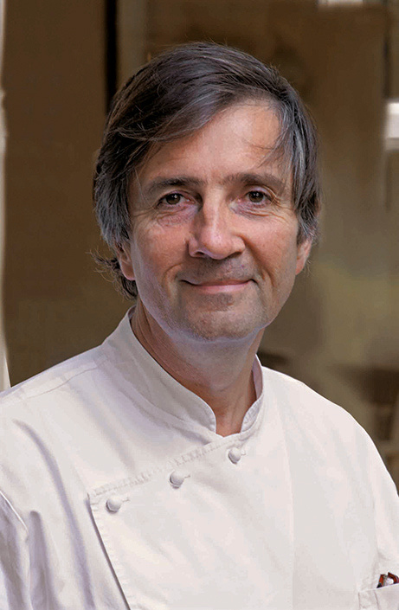
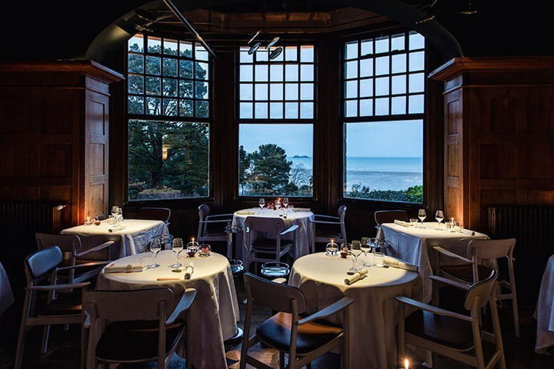
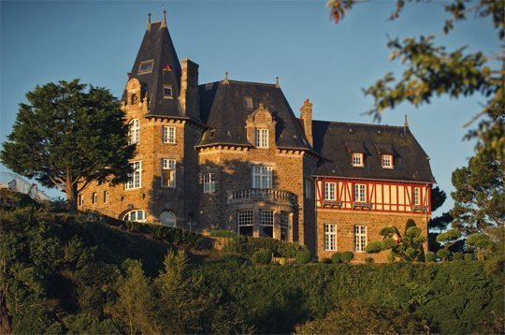
A prestigious mentor
He is a two-star Michelin chef and the owner of Les Maisons de Bricourt. He actively engages with students through multiple talks throughout the year.
Olivier Roellinger
Notes:
15

Slide 17
Bachelor in Culinary Arts and Entrepreneurship
Cookery and Bakery Option
Bachelor in F&B and Hospitality Management
Campus of Paris, Rennes and Bordeaux
Notes:
17

Slide 18
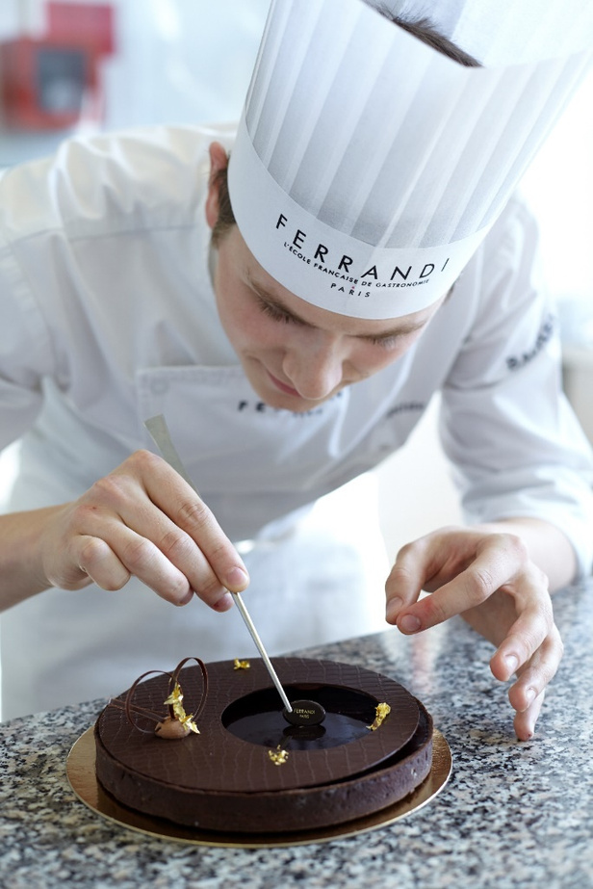
Bachelor in Culinary Arts and Entrepreneurship
Course Objectives:
Develop and master management techniques. Acquire and master operational cooking techniques to fully express your creativity.
Develop interpersonal skills in intercultural environments.
Adopt a caring and respectful approach to peers and the environment.
Program Missions:
Train skilled managers.Master the fundamentals of French gastronomy.
Develop managerial skills.
Become an entrepreneur in the catering industry.

Slide 19

Bachelor in F&B and Hospitality Management
Course’s Objectives :
Develop and master management skills to lead and develop a business in the industry.
Acquire interpersonal skills and techniques suited to the business world.
Adopt a caring and respectful approach to your peers and the environment.
Program’s Missions :
Train skilled managers.
Master the technical aspects of the industry.
Develop managerial skills.
Become an entrepreneur in the hospitality and catering sector.
Notes:
21

Slide 20
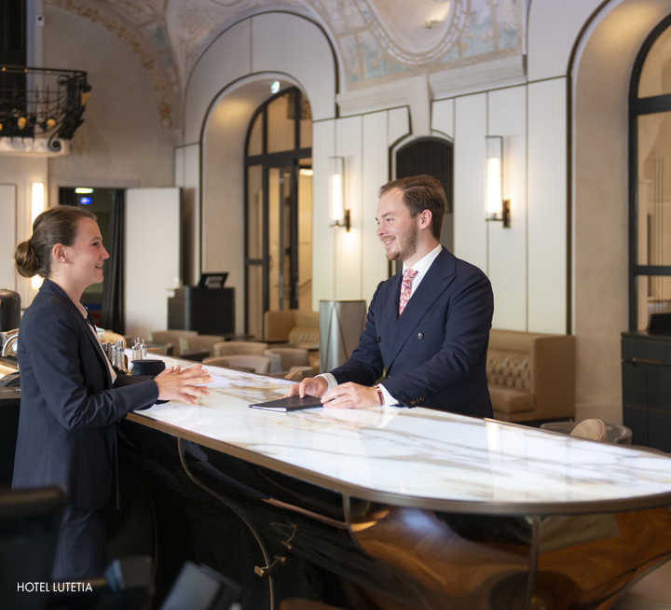
Admission conditions
General :
Applicants must be at least 18 and under 30 years old.
Hold a French high school diploma (or foreign equivalent).
Second and third year inscription:
Have enough ECTS credits (60 or 120).
Have professional experience in the gastronomy sector.

Slide 21
5 good reasons to join
FERRANDI Paris Rennes Campus
Dual expertise in managerial and operational skills
A standard of excellence: Bachelor’s degree recognized by the Ministery of Higher Education
Prestigious partners ideally located ( Brittany area)
Permanent teachers in association with a team of professionals
Offer job shadowing or training opportunities
Notes:
24

Slide 22
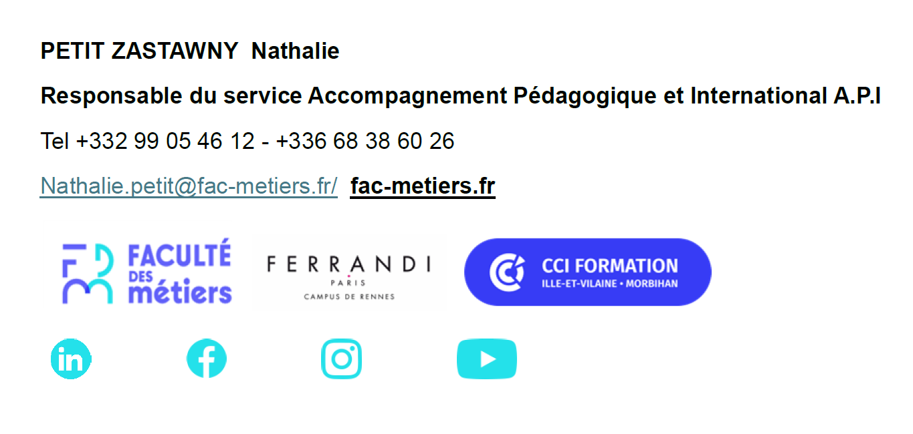
www.ferrandi-paris.fr
Ecole Ferrandi : Campus de Rennes - Ferrandi Paris
Contact in Rennes : Neil SOURGET
neil.sourget@ille-et-vilaine.cci.fr
+332.99.33.63.40

