Slide 1




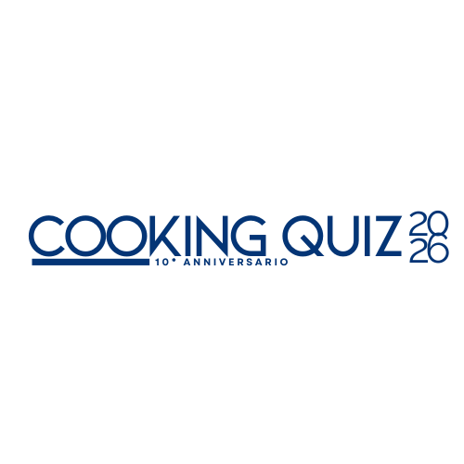




EDUCATIONAL PROJECT
aimed for
European Culinary Institutes
A.S. 2025-2026
10th Edition

Slide 2








The Cooking Quiz: A Decade of Educational Excellence
10th Edition of a highly successful educational competition
100+ Schools and 35.000+ Students engaged annually in Italy
One of the most innovative projects for Culinary Institutes
Strong Educational Focus: Allows students to deepen their knowledge of Italian cuisine and/or its goods, and cooking through a gamified approach
Participation is FREE of charge
Educational Project recognized by:

Slide 3

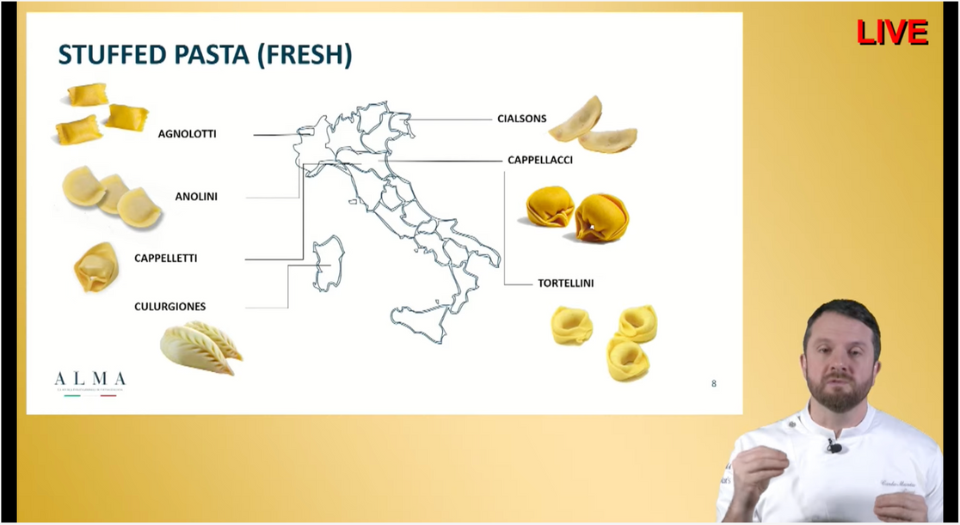
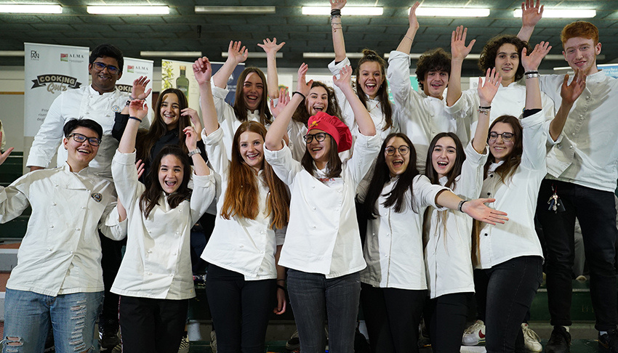
How does Cooking Quiz Works?
Phase 1: Educational Input (Tailored Live Lesson)
Targeted Audience: 3rd and 4th-year classes (enogastronomy, culinary arts, pastry/bakery)
Curriculum Integration: Dynamic lesson covering students' study plan
Expert Instruction: Live connection with ALMA Teacher/Chef that prepares a tailor-made lesson about Italian Cuisine and/or its goods
Modern Focus: Integration of modern themes: Healthy Nutrition, Local Gastronomic Excellence, and Critical industry issues like Combating Food Waste
Phase 2: Learning Verification (EDUTAINMENT)
Assessment Tool: Students use smartphones as keypads for the quiz
Content: Questions related to the lesson made by the ALMA Chef
Competitive Output: Class competition determines advancement to the final

Slide 4

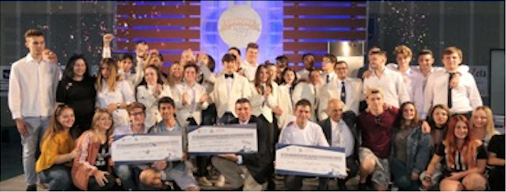
Finals and prizes
The National Final is a major in-person event scheduled for May 6th, 2026, where finalist classes compete in a grand quiz to obtain the title of INTERNATIONAL COOKING QUIZ CHAMPION 2025. Prizes and product supplies for laboratories and schools are planned, along with a PLAN EDIZIONI Library.
1 DAY TRAINING AT ALMA OR AN ALMA MASTERCLASS AT YOUR INSTITUTE
BOOK COLLECTION FROM PLAN
GADGET FOR STUDENTS

Slide 5
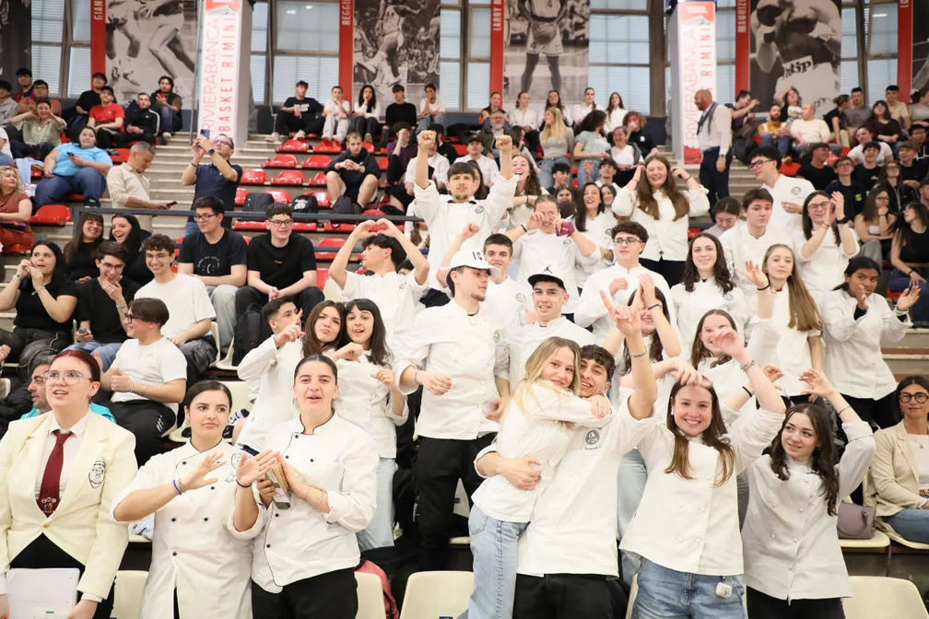

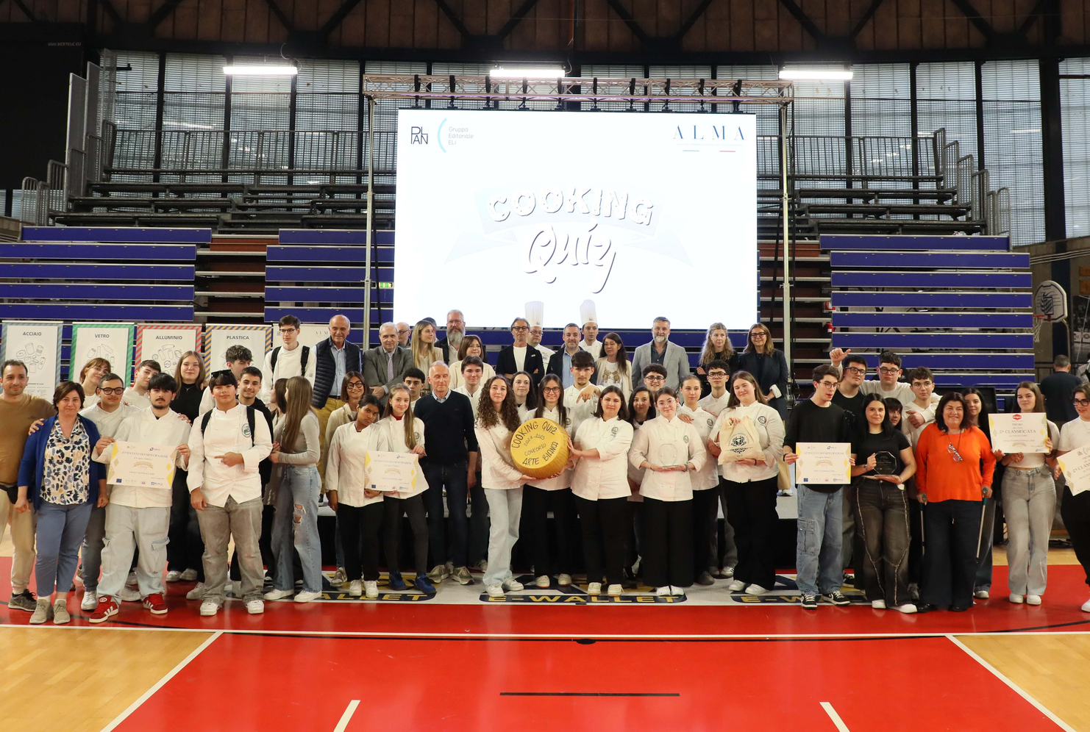
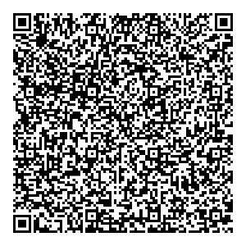
With COOKING QUIZ,
school just got tastier!
Apply online: https://www.cookingquiz.it/wp/registration-europe/
Deadline: December 31st, 2025!
WISH TO KNOW MORE?
CONTACT US:
almainternational@scuolacucina.it
WhatsApp: +39 3420464112
+390521525272

