Slide 1


School projects
Students with special needs
Jasmina Damjanović & Ana Špoljar
Turističko-ugostiteljska i prehrambena škola Bjelovar
General Assembly
AEHT Annual Conference
Västerås, November 6, 2025

Slide 2
Contents
01
Erasmus+ projects
02
National projects

Slide 3
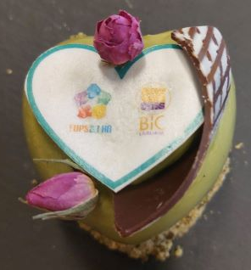
Students with special needs 2025/2026
77 students with developmental disabilities attend our school
46 of which are integrated into regular classes
31 students are educated in special classes (assistant chef and pastry chef, assistant chef and assistant waiter).
Most of them are students with mild intellectual disabilities, and some have other associated difficulties (e.g. attention deficit disorder, behavioral problems, ADHD, autism, etc.).
In addition to students with developmental disabilities, many students come from socially disadvantaged families, and some students are socially neglected.

Slide 4

Erasmus+ projects

Slide 5
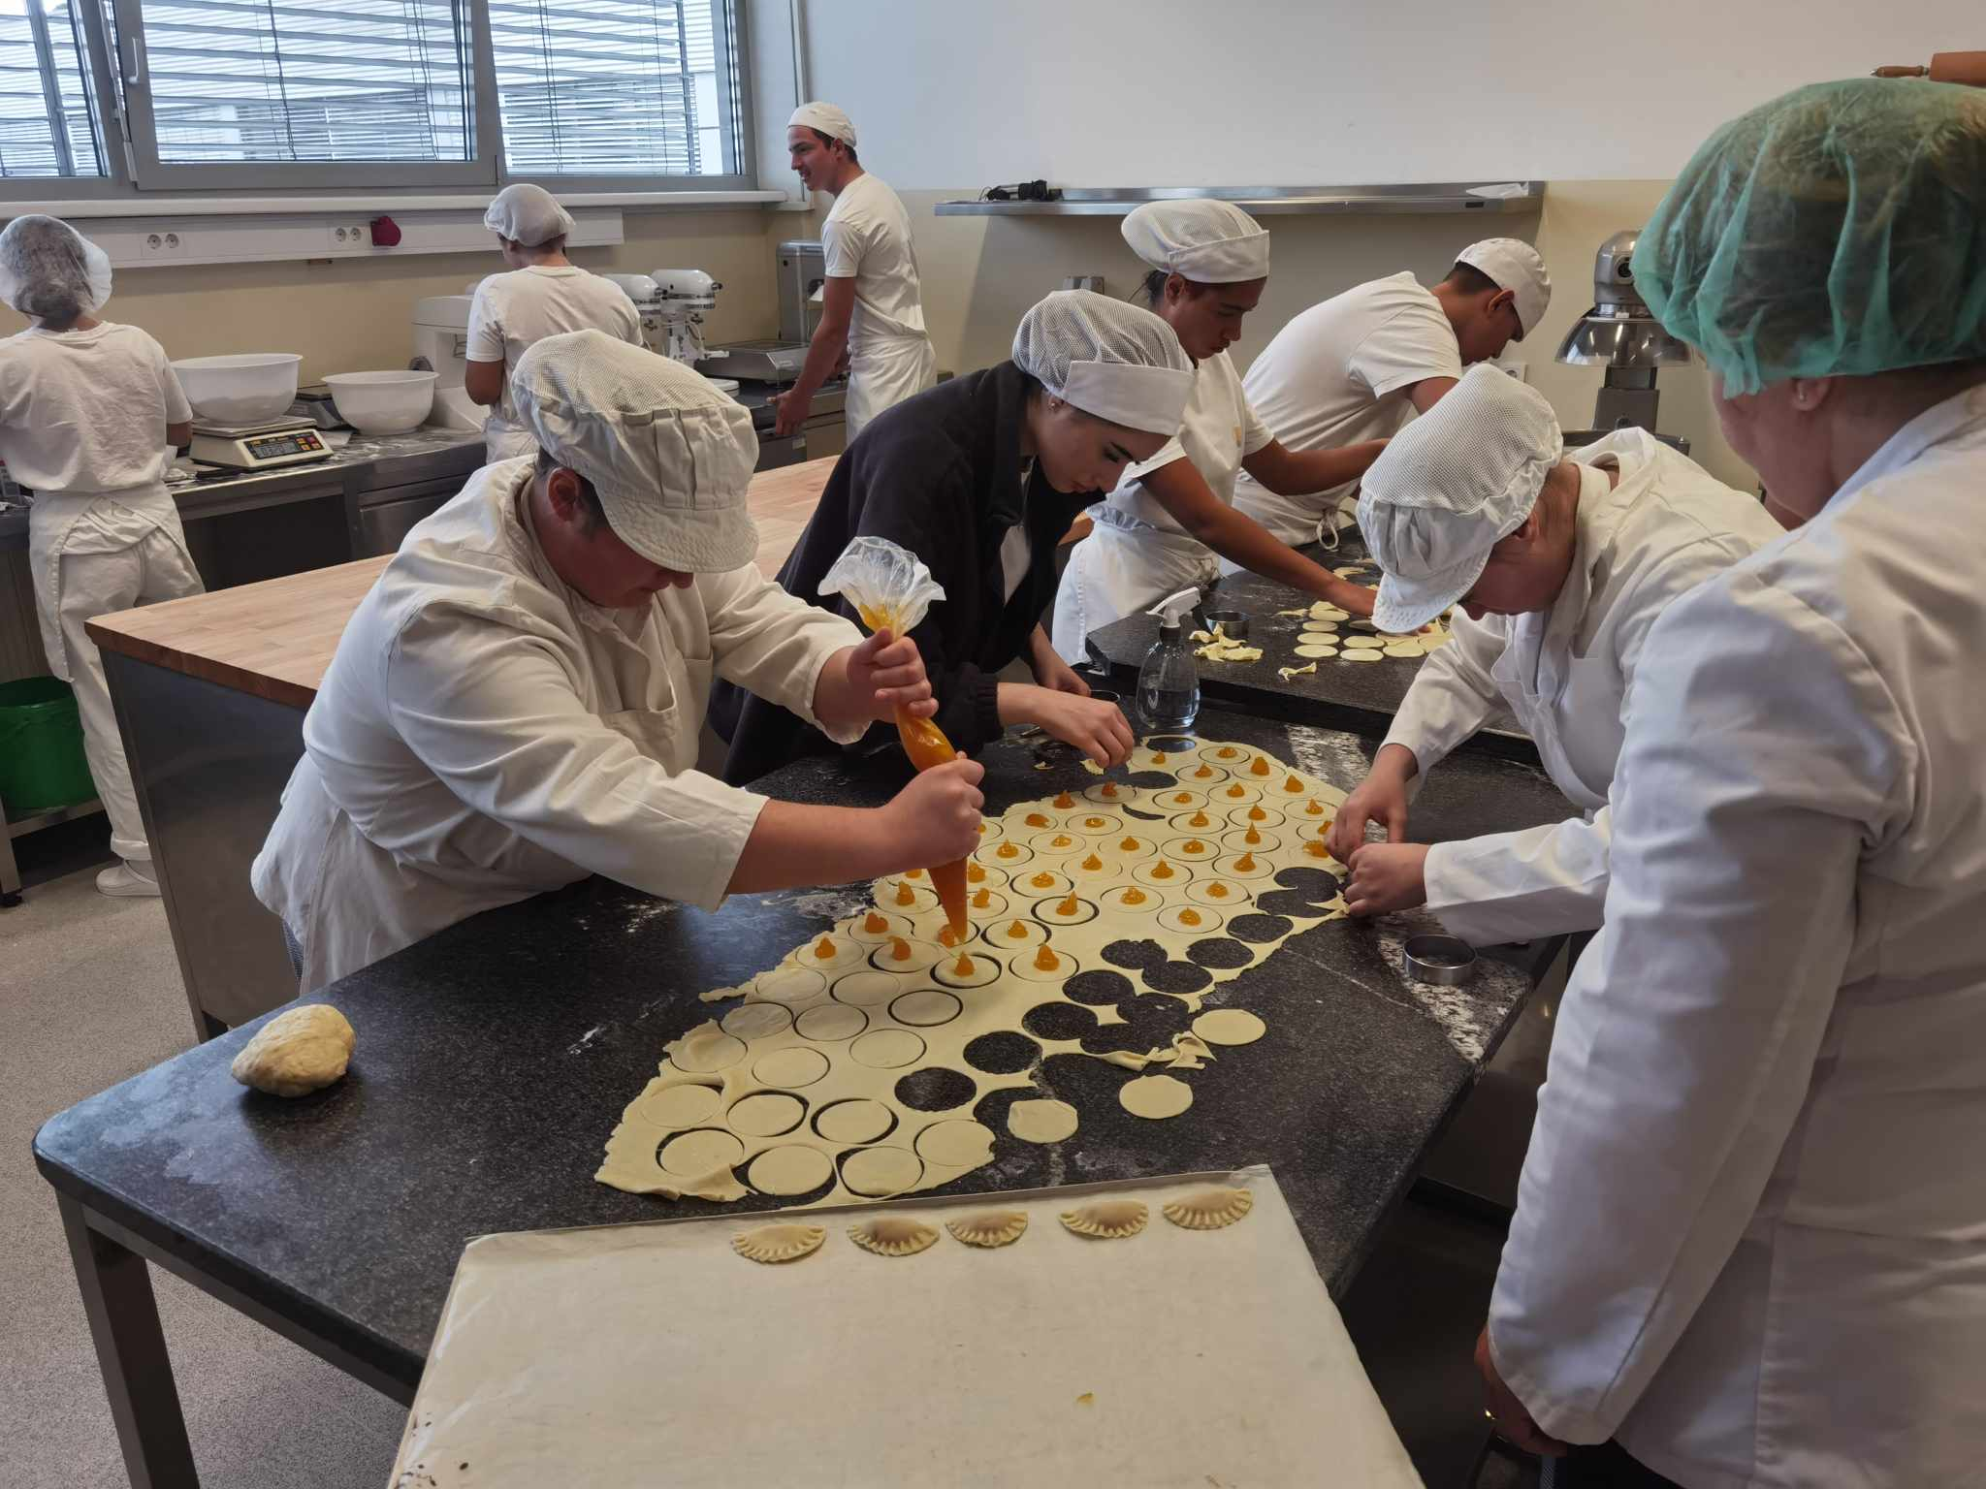
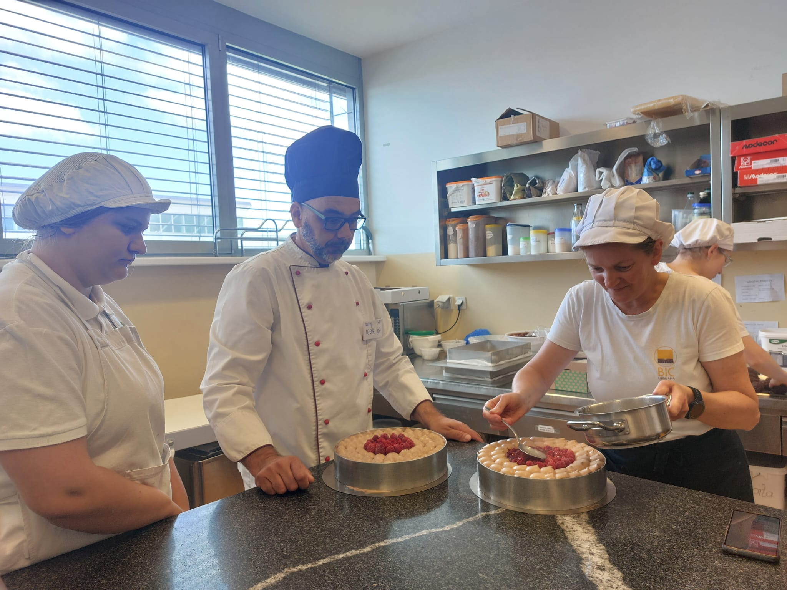
Let’s go further!
Accreditation 2
Biotechnical Education Center, Ljubljana, Slovenia
October 2023
5 students (assistant chef and pastry chef)
Cultural visits: Postojna Cave and Lake Bled, zoo
Biotechnical Education Center, Ljubljana, Slovenia
May 2025
6 students (assistant chef and pastry chef)
Cultural visits: Ljubljana, Lake Bled, Ig (Ljubljana marshes)
01
02
Accreditation 3
03
Biotechnical Education Center, Ljubljana, Slovenia
Spring 2026
4 students (assistant chef and pastry chef)

Slide 6


National projects

Slide 7
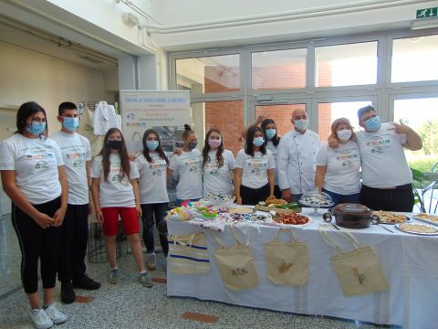
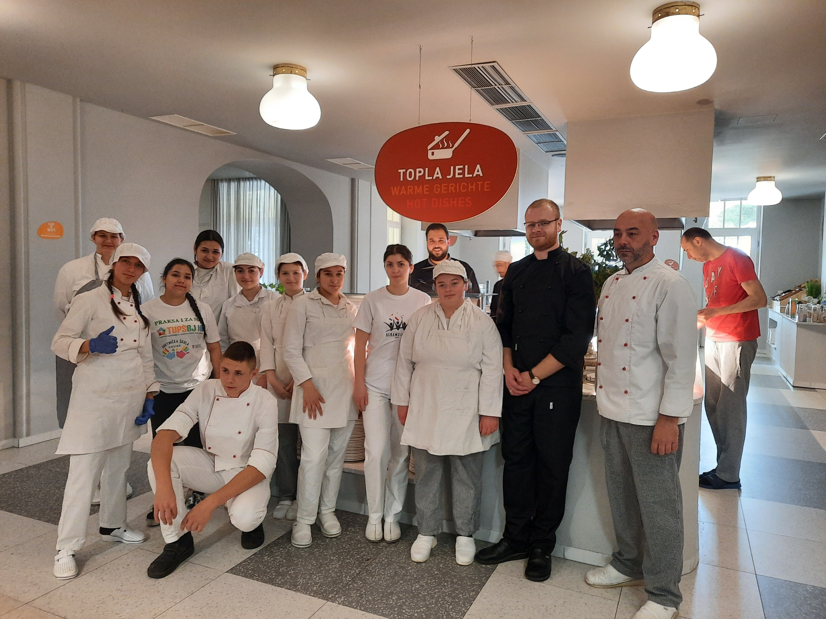
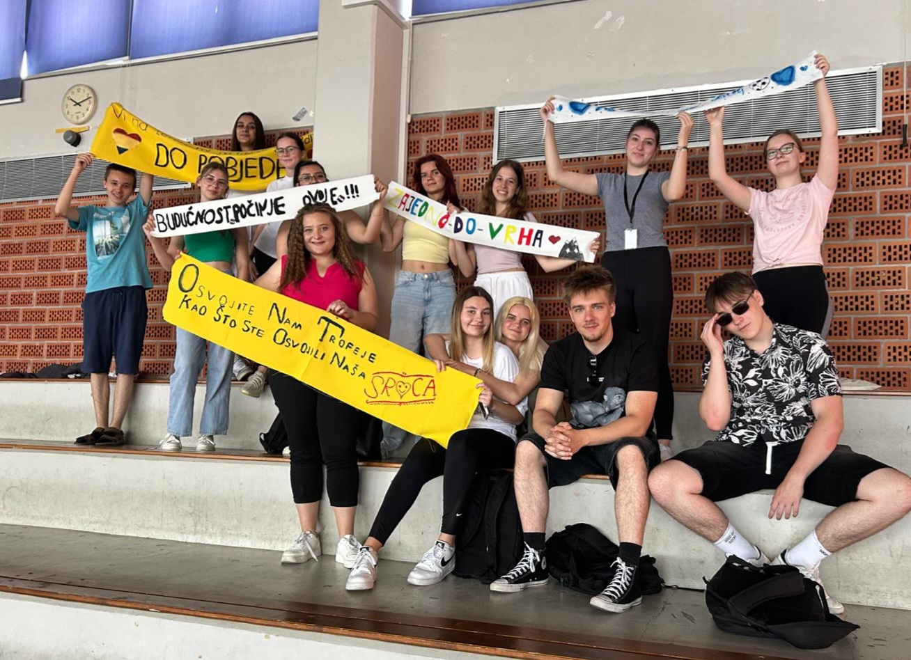
LET’S CELEBRATE EASTER TOGETHER
(PROSLAVIMO USKRS ZAJEDNO)
School year 2020/2021
Partner: Crafts Vocational School Osijek, Croatia
Students from year 1-3
AIM: To promote tourism in the area, encourage teamwork and creativity
1.
INTERNSHIP FOR US TOO (PRAKSA I ZA NAS)
School year 2022/2023
Partners: Crafts Vocational School Osijek, Croatia
‘’Lišanj’’ Hotel, Novi Vinodolski, Croatia
15 students
AIM: To develop students’ competences for jobs
in tourism
2.
3.
CHOOSE FAIR PLAY!
(IZABERI FAIR PLAY!)
School year 2024/2025
AIM: To develop self-esteem and
teamwork, promote tolerance,
acceptance and respect

Slide 8
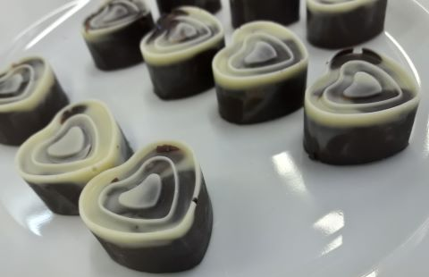
Thank You

