Slide 1


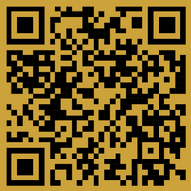
Hotel Academy Prešov, Slovakia
presents a competition for junior
BARTENDERS
BARISTAS
FESTIVE TABLES
each OCTOBER
Organiser:
Hotel Academy
Baštová 32, Prešov
080 01 Slovakia
Contact Person:
PhDr. Marek Šebej, MBA
+421 948 885 766
eurocup@hapresov.edu.sk
en.eurocup.sk

Slide 2
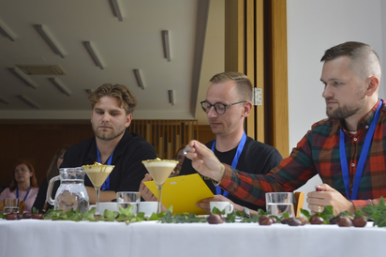
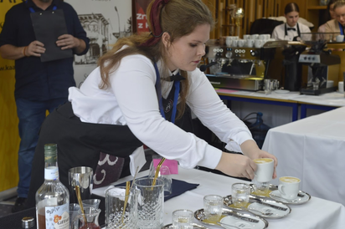
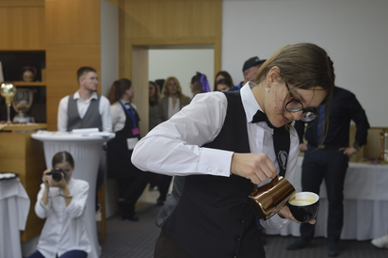
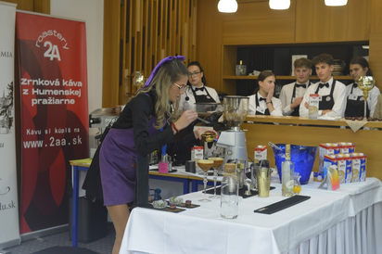

Slide 3
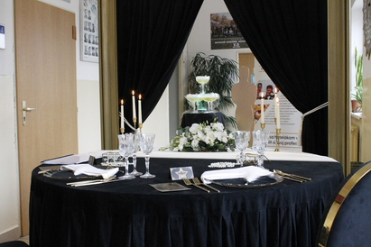
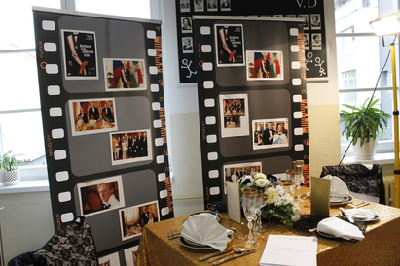
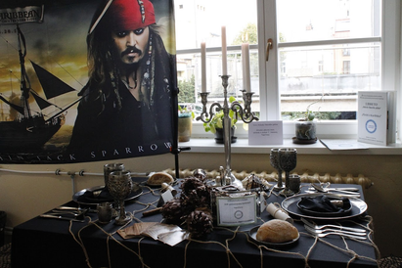
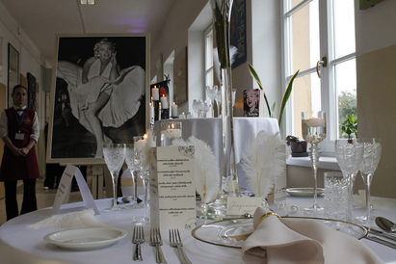

Slide 4
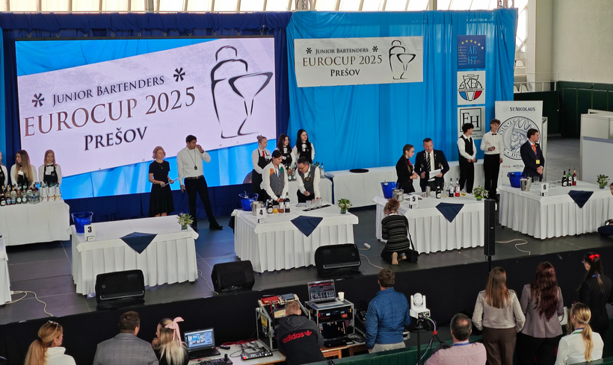
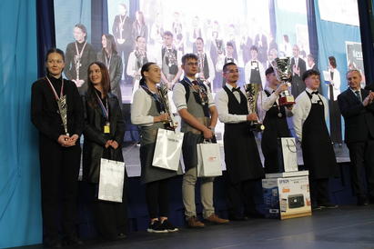
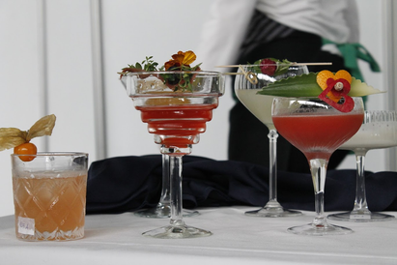
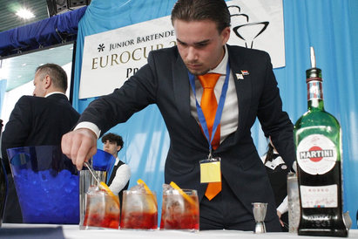

Slide 5
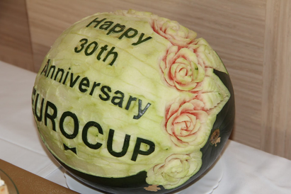
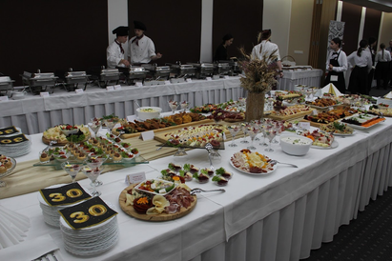
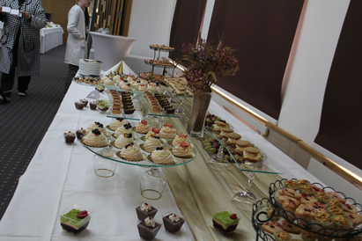
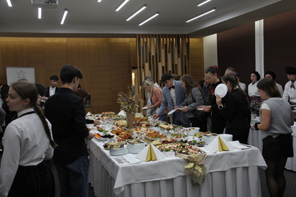

Slide 6
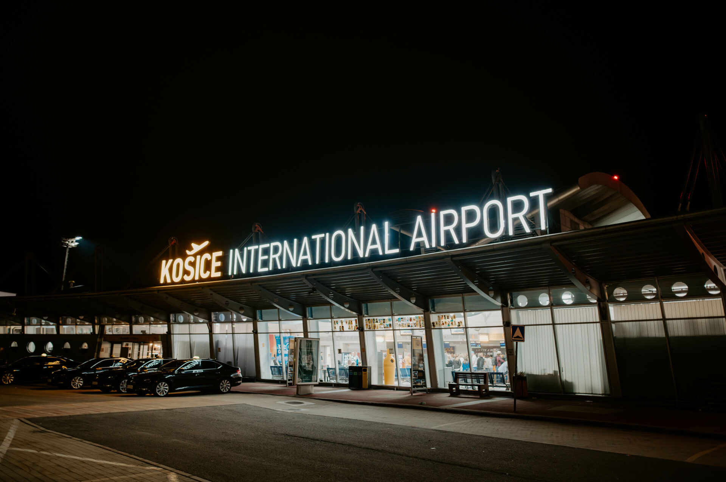
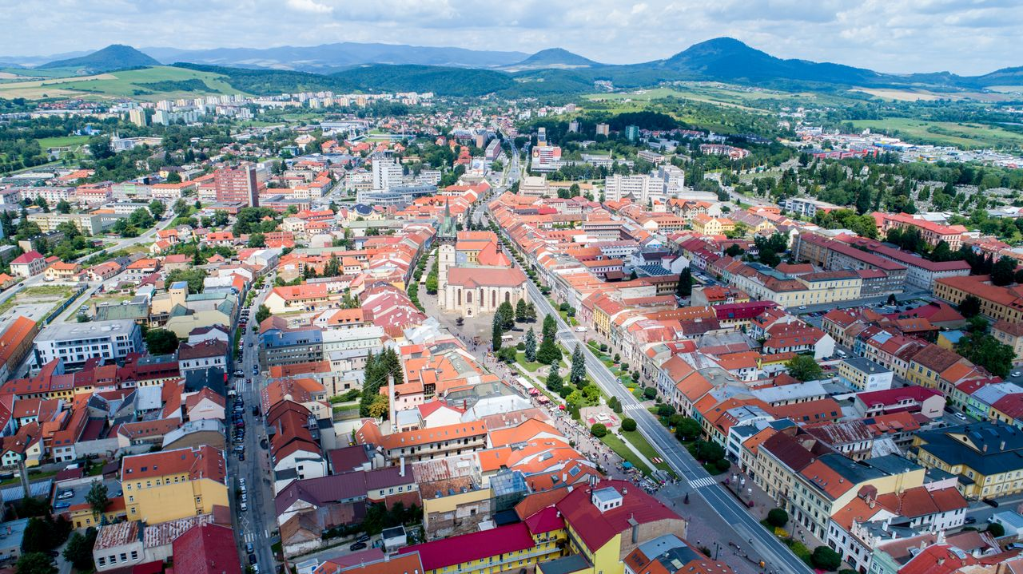
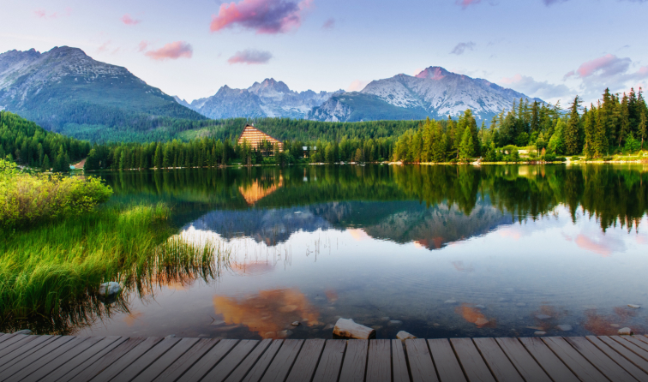
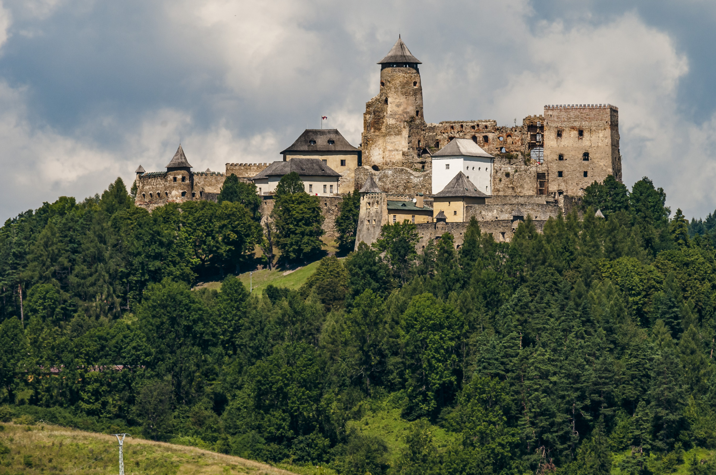

Slide 7
October 6-7, 2026
BARTENDERS
BARISTAS
FESTIVE TABLES
Organiser:
Hotel Academy
Baštová 32, Prešov
080 01 Slovakia
Contact Person:
PhDr. Marek Šebej, MBA
+421 948 885 766
eurocup@hapresov.edu.sk
en.eurocup.sk

Slide 8

