Slide 1
Christmas in Europe 2024
ROC Mondriaan – The Hague, The Netherlands
December 1-6, 2024

Slide 3
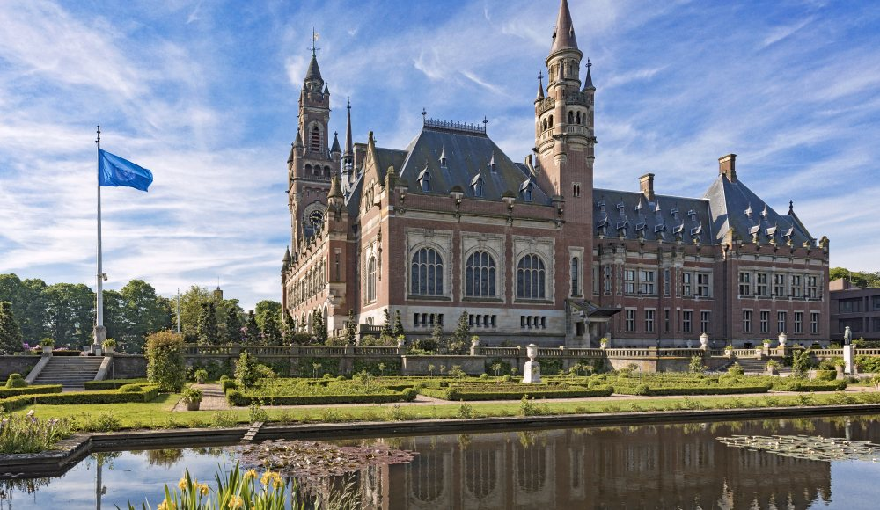

Slide 6
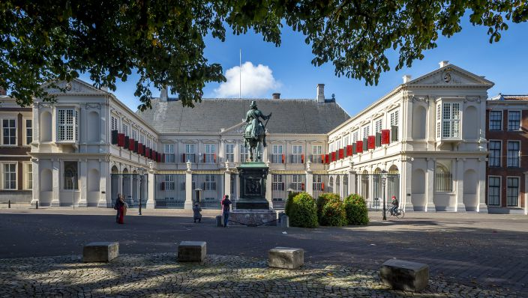

Slide 7
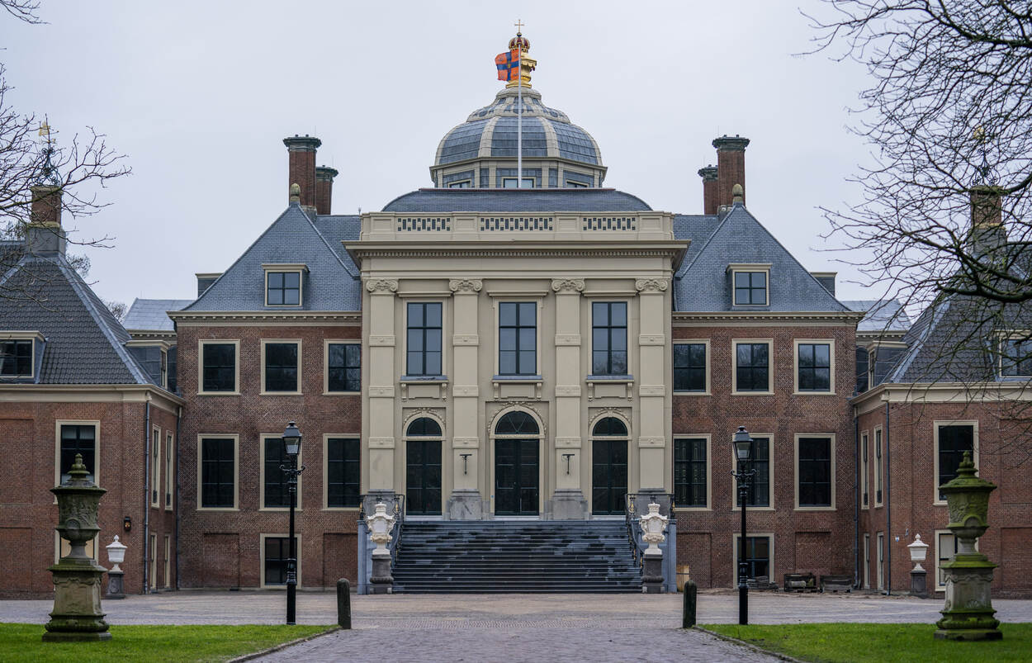

Slide 8
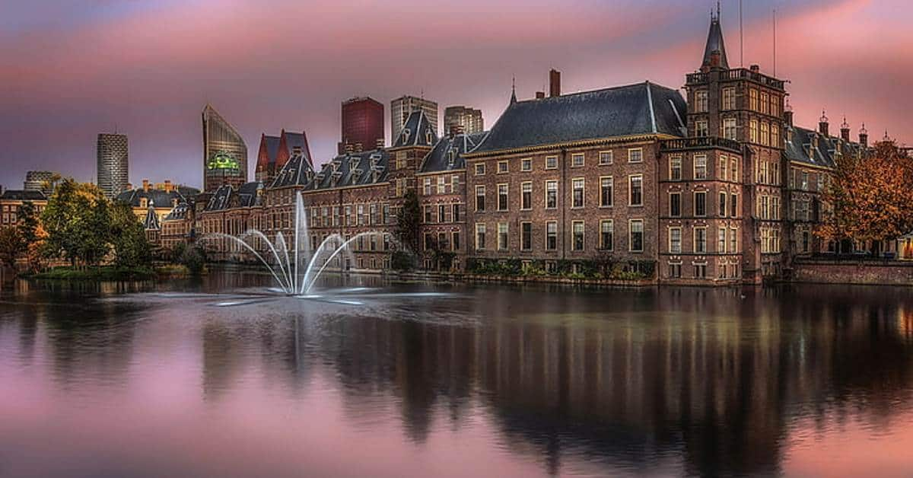

Slide 9
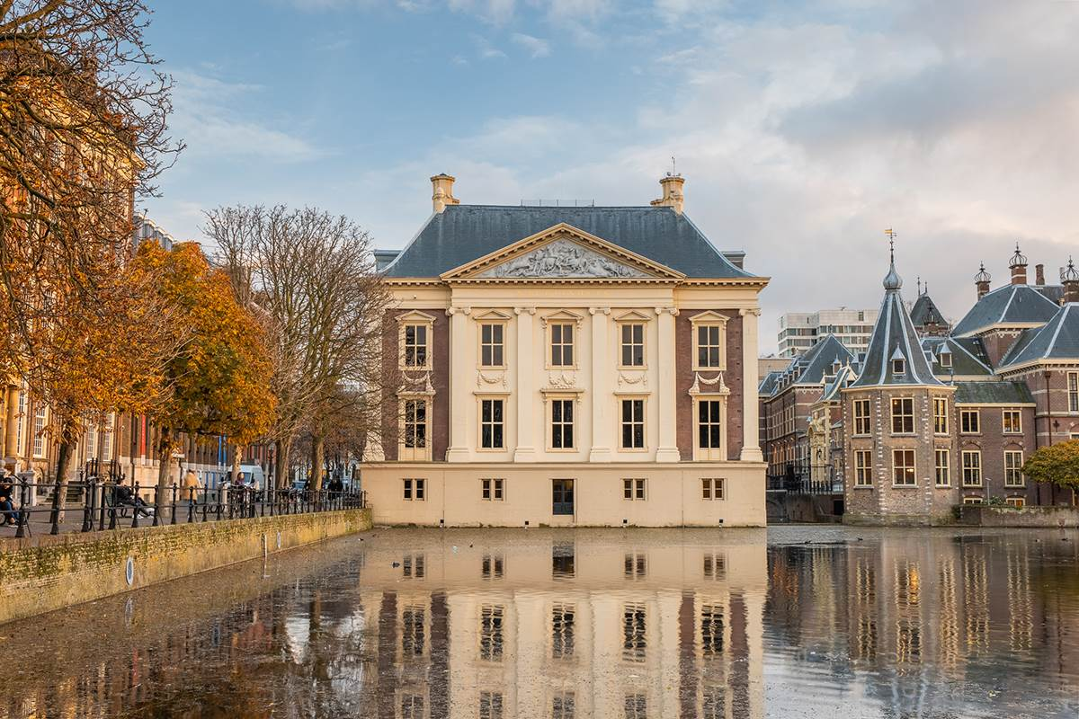

Slide 14
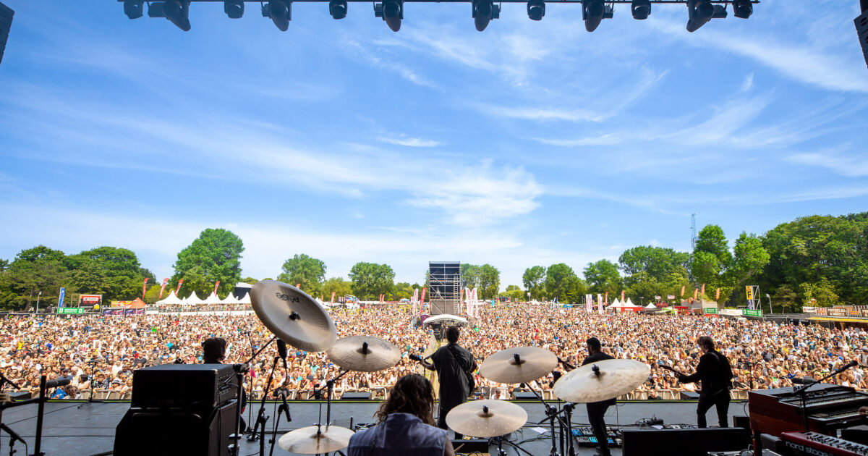

Slide 15
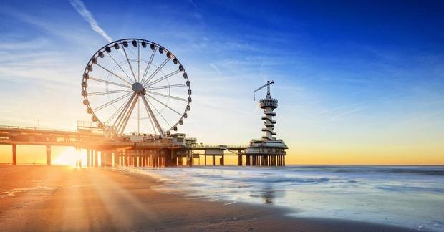

Slide 16
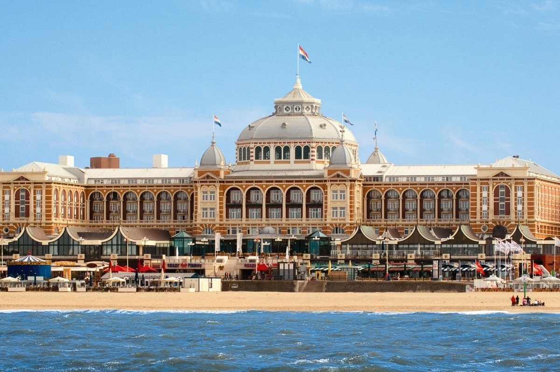

Slide 17
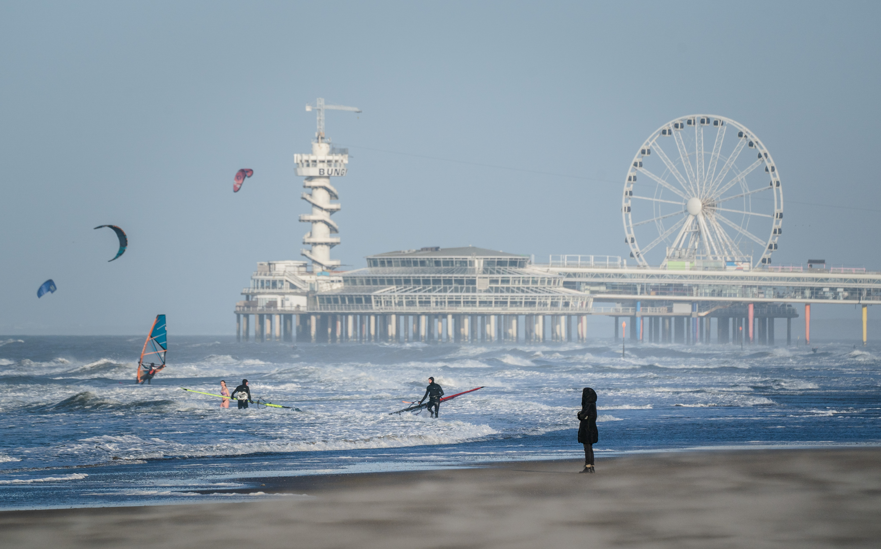

Slide 18
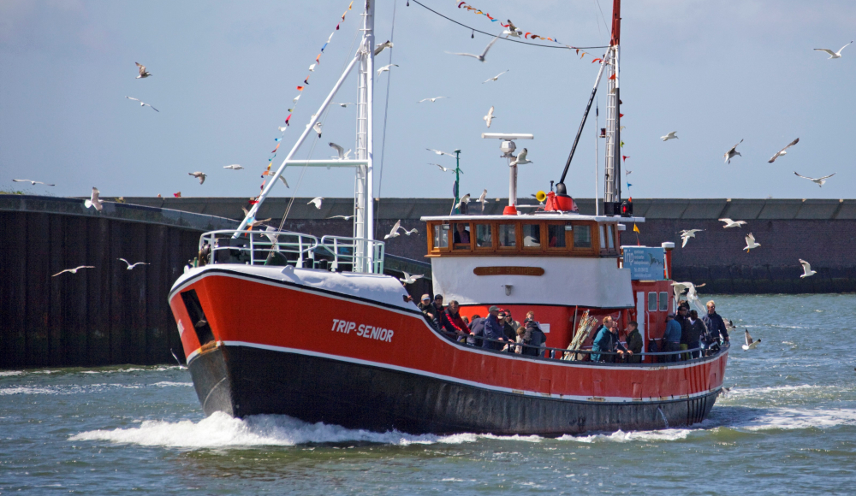

Slide 19
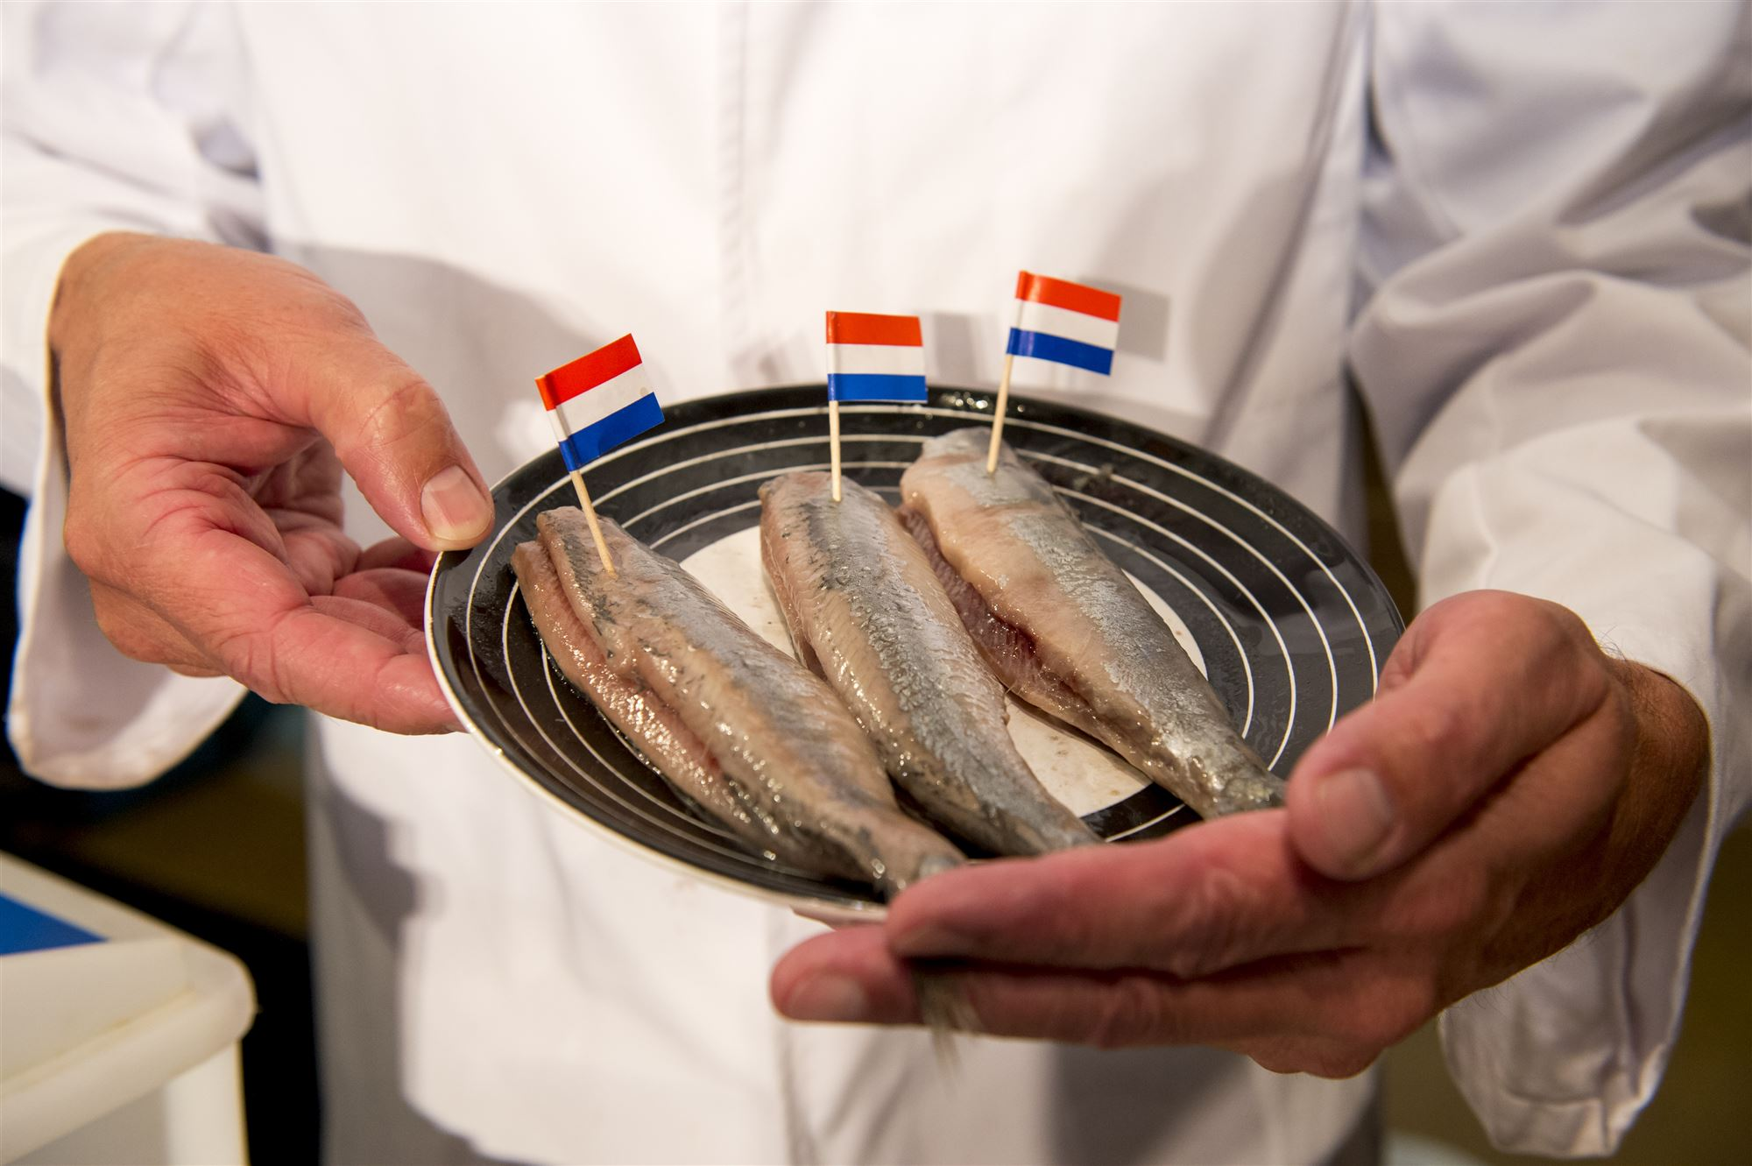

Slide 22
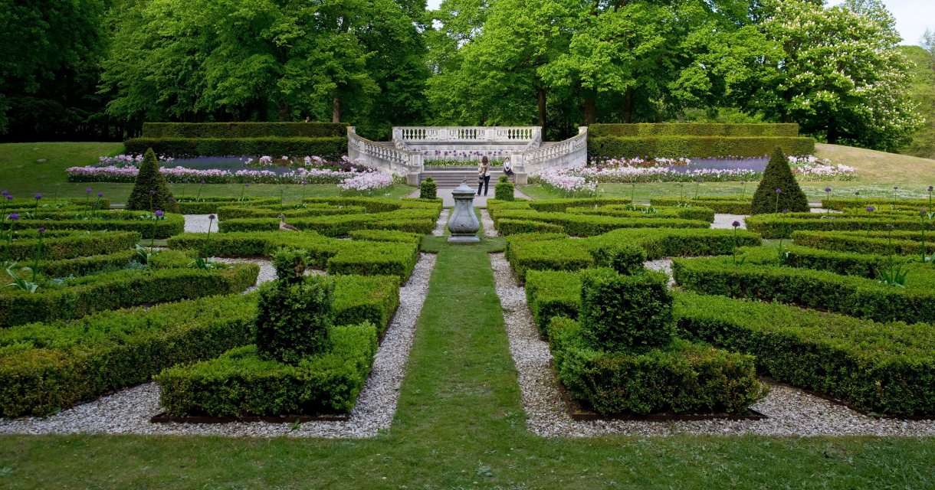

Slide 25
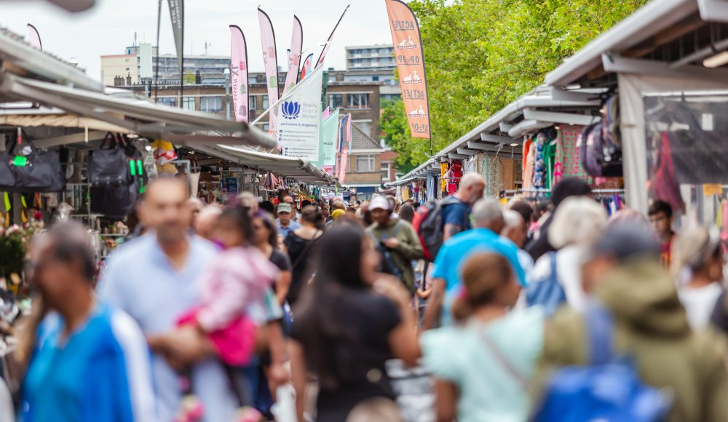

Slide 26
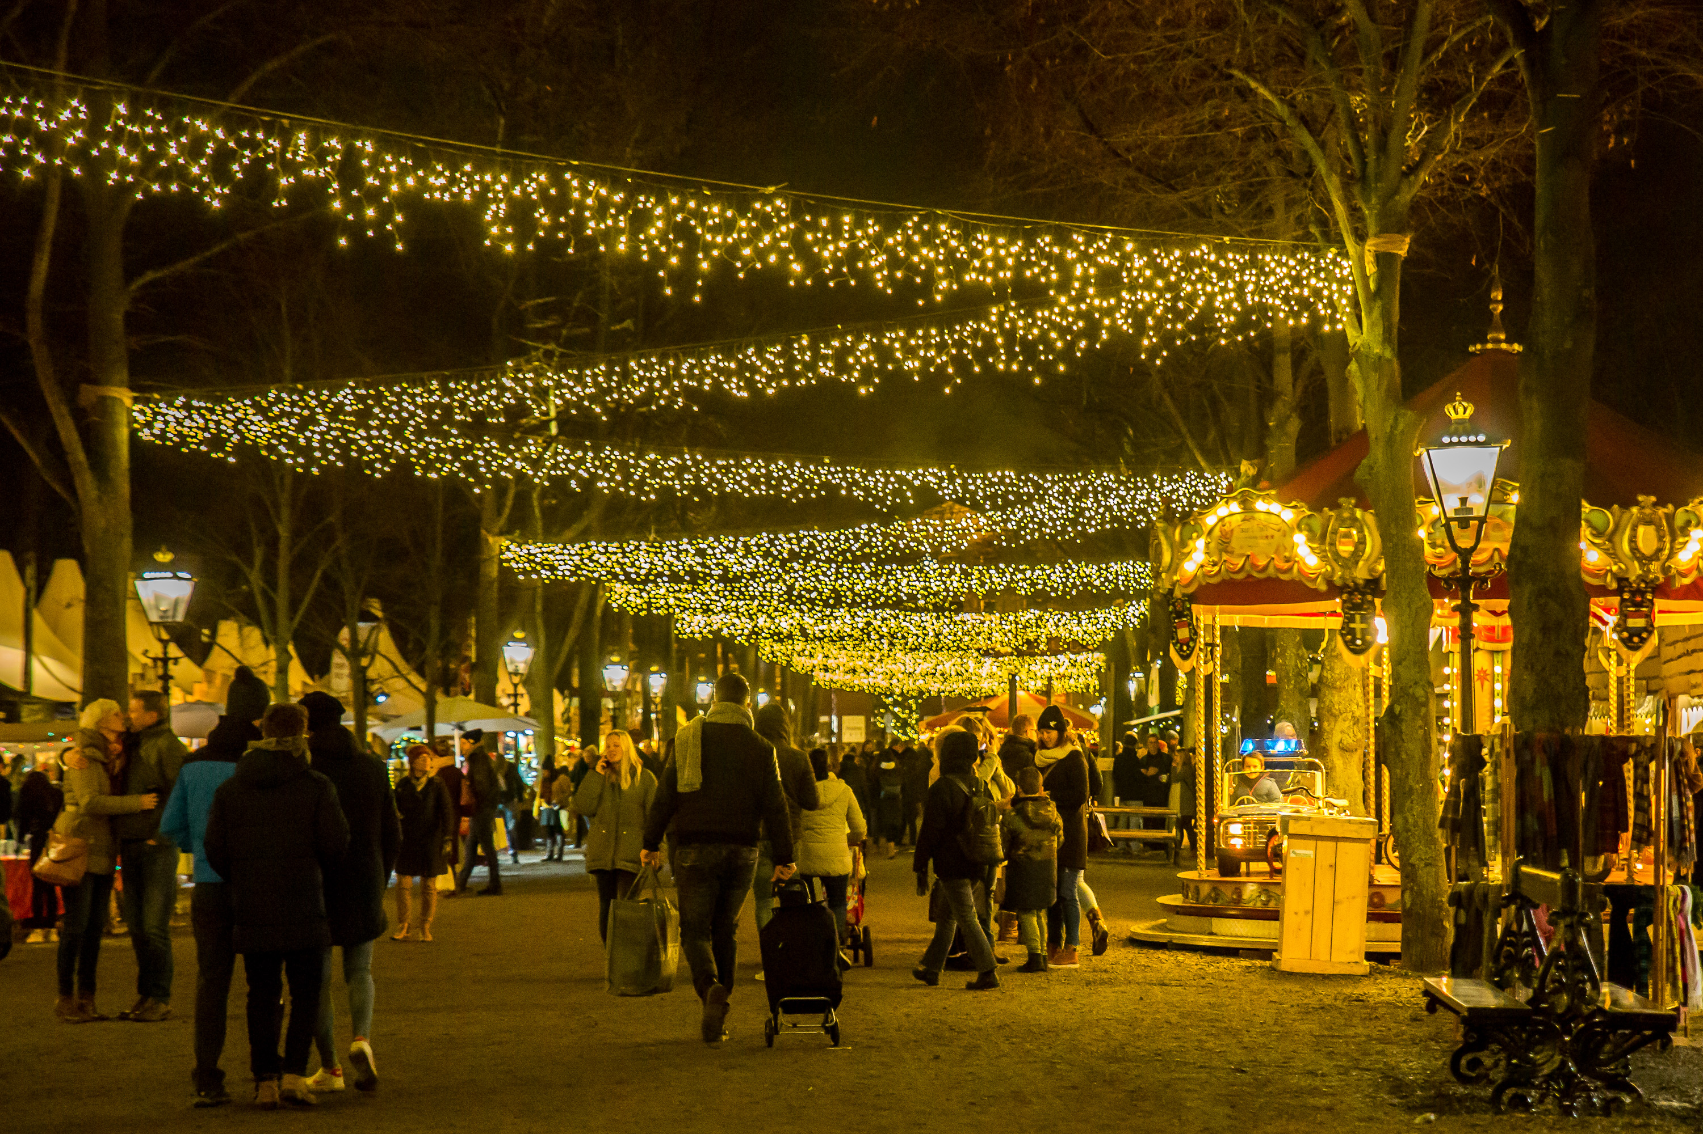

Slide 27
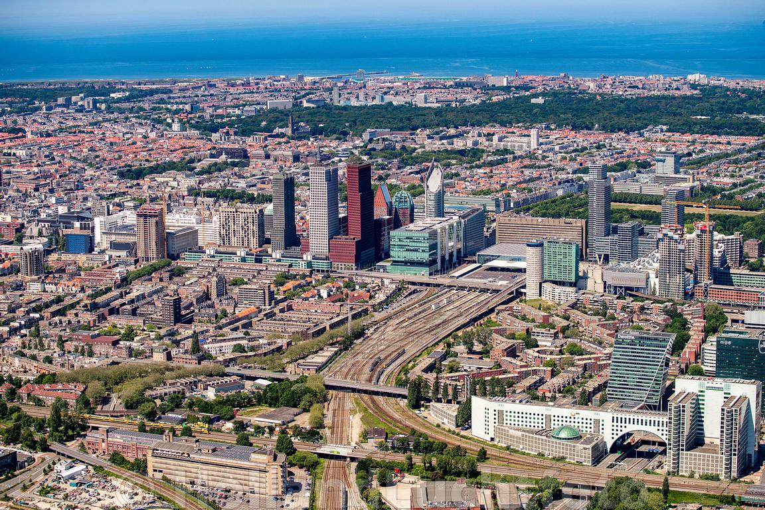

Slide 29
Vocational Education (levels 1 to 4)
The Hague and 8 surrounding cities and villages
20.000 students in over 200 courses
25 schools
6 campuses

Slide 30
Christmas in Europe 2024
School for Hospitality & Facility Management
School for Tourism, Leisure & Event Management

Slide 31
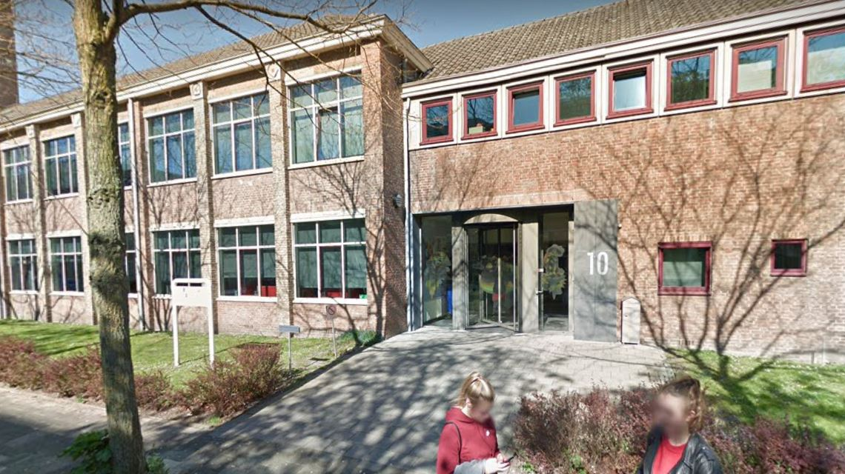

Slide 32
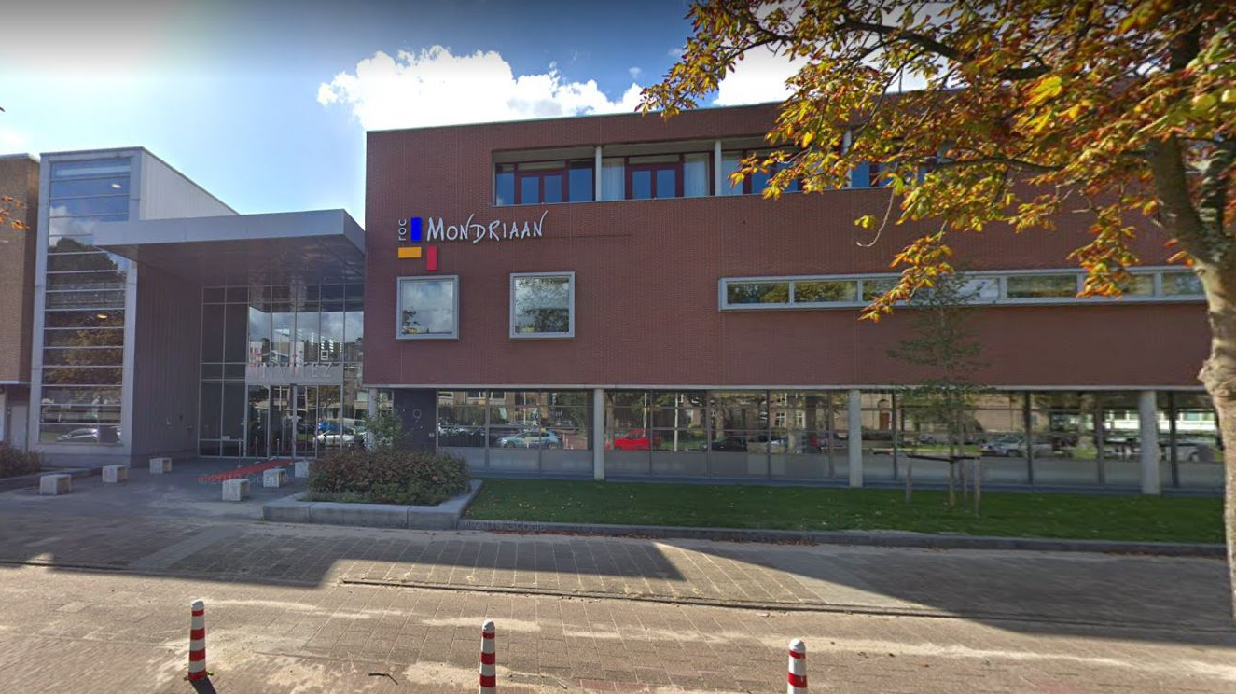

Slide 34
Christmas in Europe 2024 – The Hague
December 1 – 6, 2024
ROC Mondriaan in The Hague
Cultural exchange
European buffet
Cultural acts
Accommodations in The Hague
Application for funding by Erasmus program

Slide 36
Christmas in Europe 2024 – The Hague
Invitation: join us next year in The Hague for Christmas in Europe
Application starts in first months of 2024
Interested in updates and newsletters: xmas-in-europe-2024@rocmondriaan.nl

Slide 37
See you next year in The Hague

