Slide 1

Presented by Candida D’Elia

Slide 2
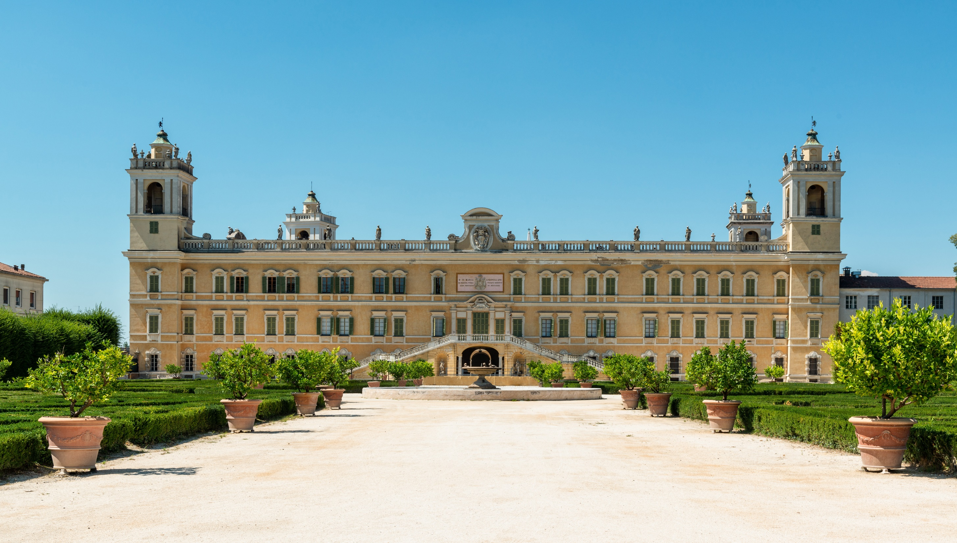

ALMA is the world’s leading international educational and training centre for Italian Cuisine and Hospitality.
ALMA educates chefs and pastry chefs, bakery chefs, gelato and pizza artisans, assistants restaurant & bar managers and food &
beverage managers coming from all around the world.
ALMA is based in the Ducal Palace of Colorno.

Slide 3









CERTIFICATIONS AND AWARDS
ALMA affirms its authority and reliability as a higher education centre in the hotel and catering sector through the awards it has earned and the certifications achieved for its courses:
ALMA is certified by the Emilia Romagna under code 5290 for training programmes
ALMA is certified UNI EN ISO 9001:2015 by SGS Italia spa for design and performing of training courses for restaurant and hospitality business operator. Design and management of team-building programs, conventions for companies and commercial organizations, and cultural and enogastronomic events.
Memorandum of Understanding with the Ministero della Pubblica Istruzione Università e Ricerca (MIUR – Ministry of Education)
ALMA works with the Istituto italiano per Il commercio Estero (ICE) (Italian Chamber of Commerce for Overseas Trade) to promote Italy’s food and agricultural heritage around the world and participates in the steering committees of the Week of Italian Cuisine in the World;
ALMA works with the University of Parma to promote the region
ALMA participates in the steering committees of Parma City of Gastronomy
ALMA has received the CRIBIS Prime Company Recognition as Company with the Maximum Commercial Reliability

Slide 4



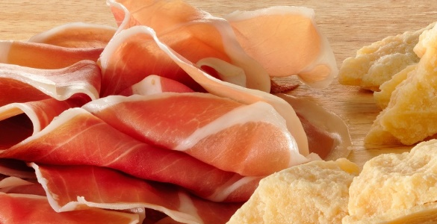
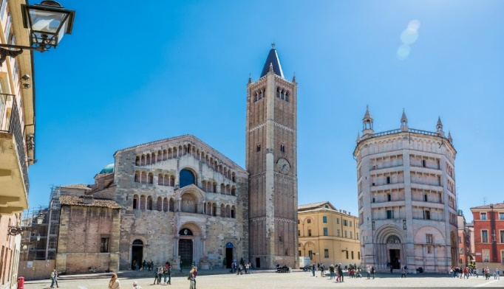
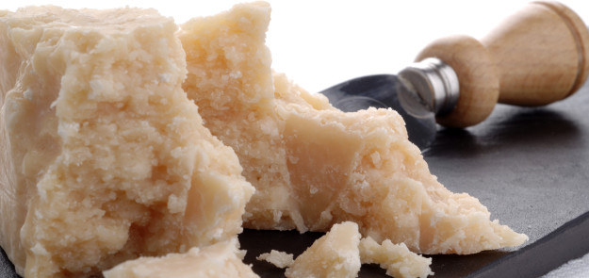
LOCATION
ALMA school is located in the heart of Italian Food Valley, an area where
you can find the most important Made in Italy products, such as Parmigiano Reggiano and Prosciutto di Parma, which make Italian food renowned throughout the world.
Parma is Creative City of Gastronomy since 2015 and has been elected Capital of Culture 2020.

Slide 5
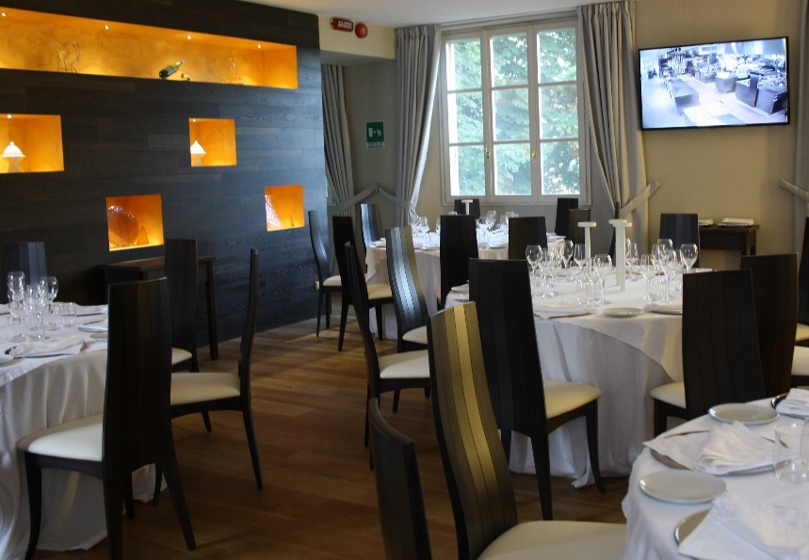
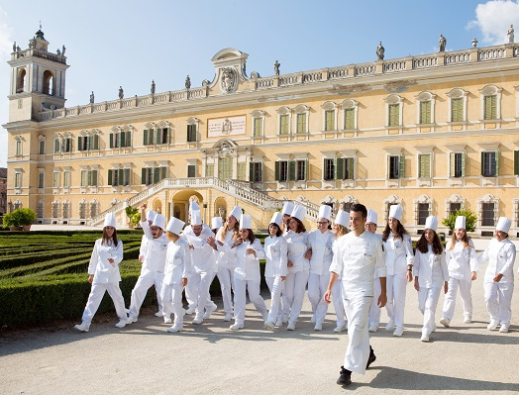
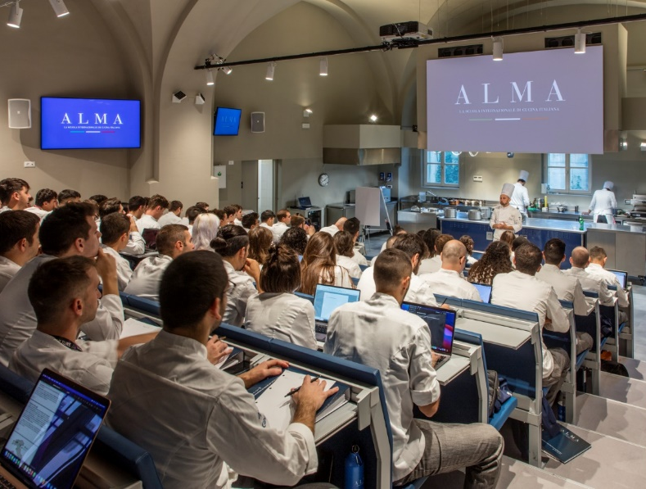
THE HEADQUARTERS
Lecture Hall (Aula Magna)
Agorà room
Demo Rooms
ALMA 12- multipurpose hall
Training Rooms
Pastry Centre
5.240 SM
23 ROOMS
6 HOUSINGS
Teaching Wine Cellar
Sommellerie Room
Management Centre
ALMA Lab
Teaching restaurant “Mater”
Caffè Italia

Slide 6
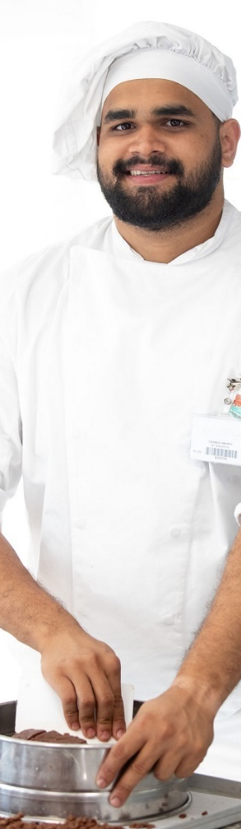
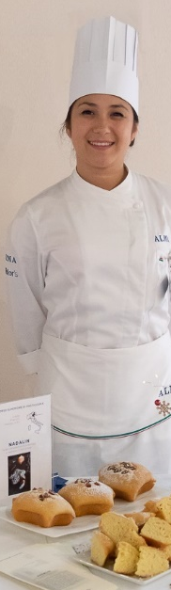
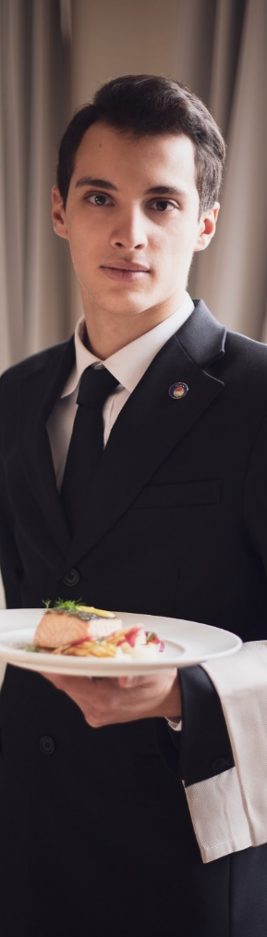
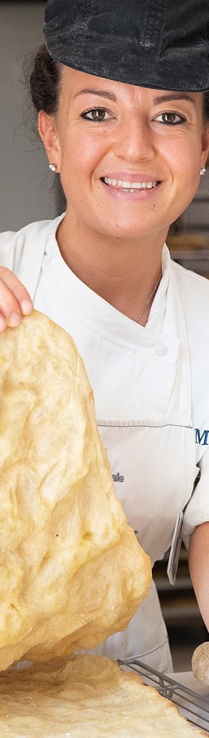
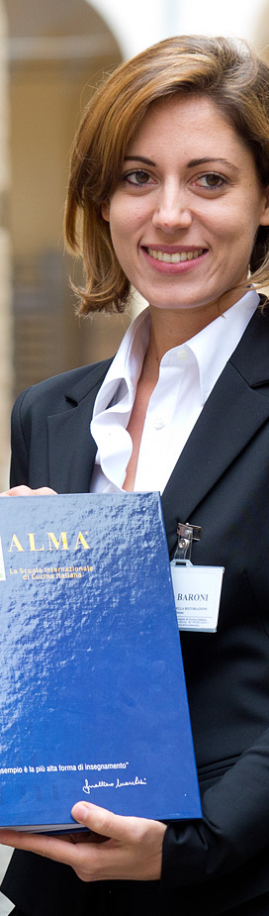
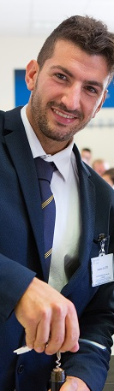
COURSES AND PROGRAMS
ALMA educates chefs and pastry chefs, bakery chefs, gelato and pizza artisans, assistants restaurant & bar managers and food & beverage managers coming from all around the world with training programs performed at the highest level by the most renowed teachers.
ALMA is a privileged meeting point. Every day, the Reggia di Colorno is the scene of lectures, conferences, seminars as well as tailor-made courses.
The international network of partner schools, the professional courses, the library, classrooms with cutting-edge technology and the ALMA Alumni Community make the school a lively centre for research and cultural exchange.

Slide 7
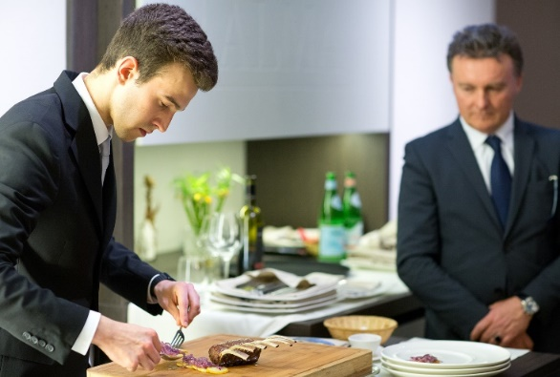
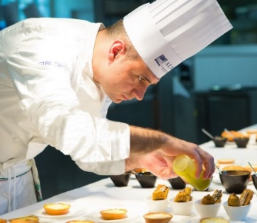
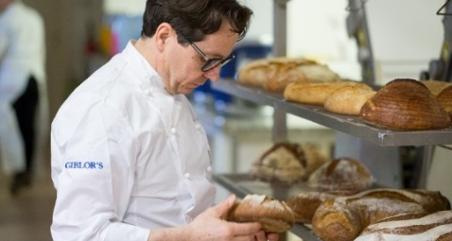
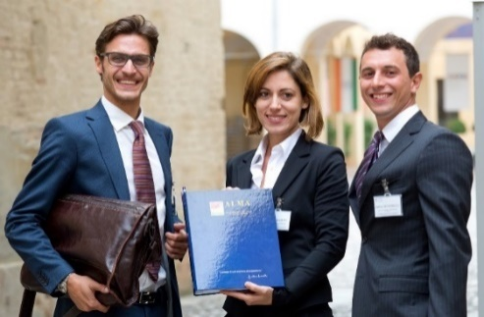
COURSES AND PROGRAMS| Italian language
CUISINE
Cooking Techniques Course
Advanced Course Of Italian Cuisine
Pasta Making Course
Master Health & Performance Chef
PASTRY
Basic Pastry Techniques Course
Advanced Pastry Course
Contemporary Gelato Course
HOSPITALITY AND SOMMELLERIE
Advanced Course Of Restaurant, Bar & Sommellerie
Master ALMA AIS
MODERN BREADMAKING
Course In Modern Breadmaking
Corse In Gastronomic Pizza
FOOD & BEVERAGE
Food & Beverage Manager Course
Food&Beverage Business Game

Slide 8
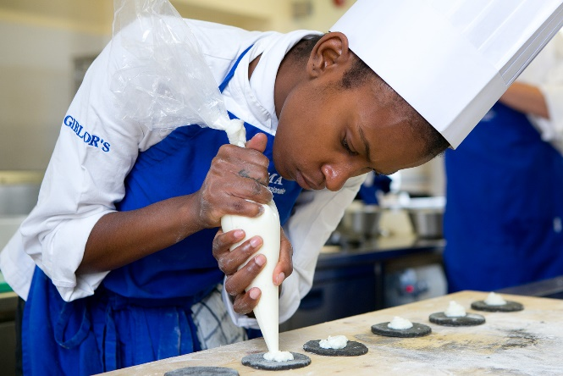
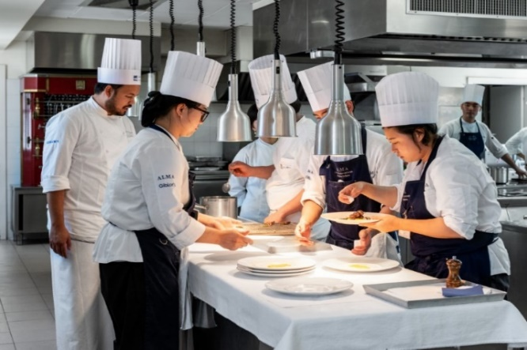
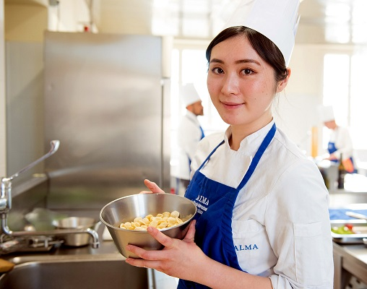
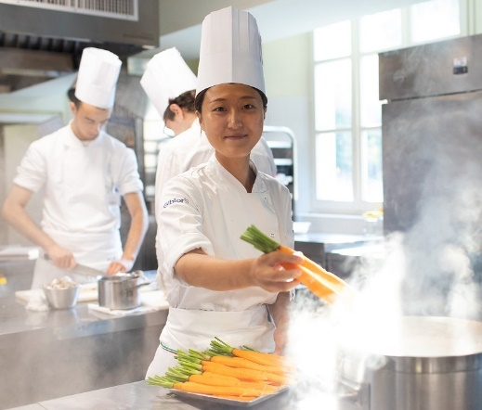
COURSES AND PROGRAMS| English language
HIGH EDUCATION
Italian Culinary Program
ICONIC COURSES
Italian Pastry Program
Italian Pizza Program
Italian Pasta Program
TAILOR MADE COURSES
A taste of Italy

Slide 9


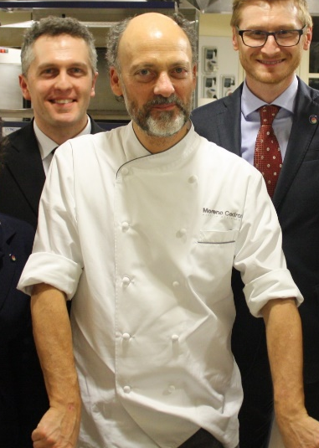
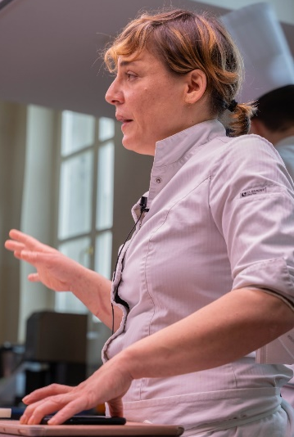
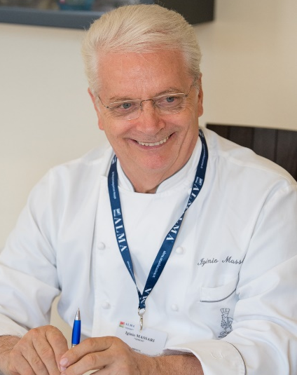
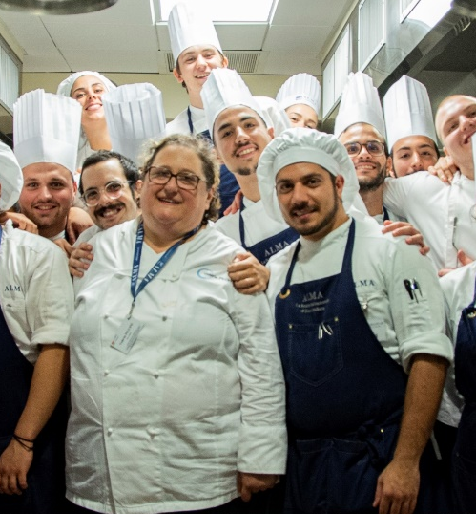
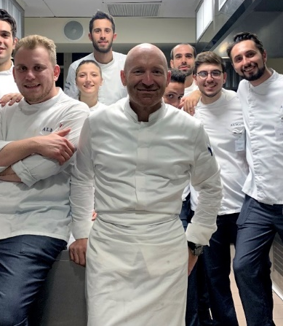
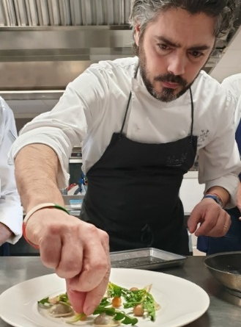
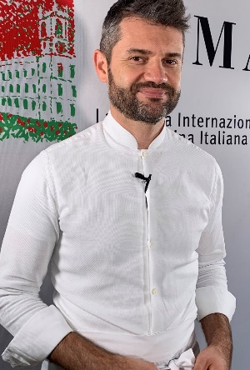
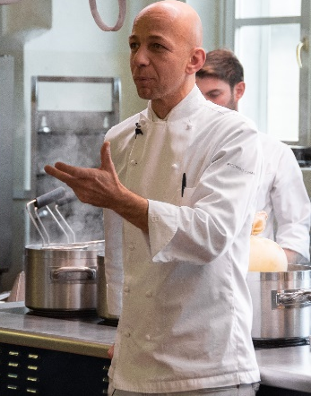
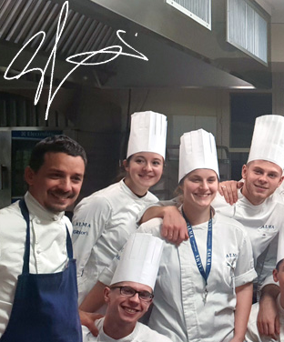
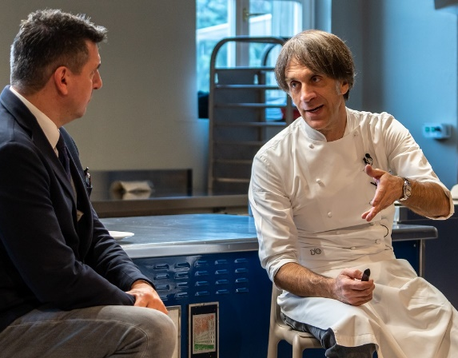
TEACHERS AND GUEST CHEFS
Data refers to 2019
17
ALMA CHEF TEACHERS
70
Chef Moreno
Cedroni
CUSINE AND PASTRY
GUEST CHEFS
Chef Antonia
Klugmann
Chef Iginio Massari
Chef Valeria Piccini
Chef Gianluca
Gorini
Chef Matteo
Baronetto
Chef Enrico
Bartolini
Chef Riccardo
Camanini
Chef Davide Oldani
Chef Alfio Ghezzi

Slide 10
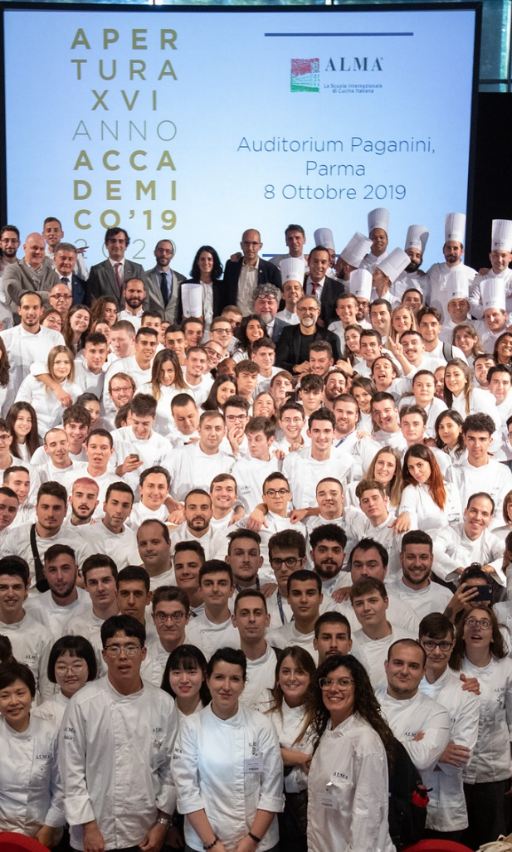





OUR STUDENTS
Data refers to 2019
80
NATIONALITIES
966
ITALIAN STUDENTS
119
INTERNATIONAL STUDENTS
TOTAL
1.085
MEDIUM AGE
25 y.o.
MALE STUDENTS
62%
FEMALE STUDENTS
38%

Slide 11
















CAREER SERVICE
ALMAlink actually helps graduates in finding their way into the working life by linking them to restaurants, hotels and all companies where the high competencies acquired in ALMA can be a precious added value. All of this is possible via the portal www.almalink.it.
A ‘virtual notice board’ is restricted to ALMA graduates of the advanced courses and is also accessible to companies looking for qualified professionals.
It is a fundamental opportunity for graduates to stay up-to-date with the best job opportunities for their professional growth in Italy and all over the world and is a unique tool for companies looking for well-trained staff.
*Examples seen above are not representative of all the career service partners

Slide 12
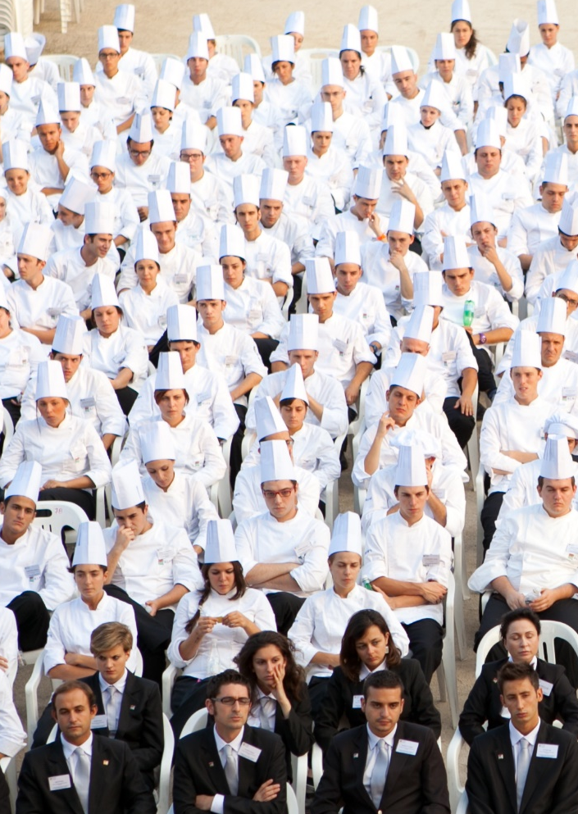


GRADUATES AND JOB
Data refers to 2019
30,5%
FIND JOB AT THE END OF THE COURSE
85%
3
FIND JOB WITHIN 3 MONTHS AFTER THE GRADUATION
94,5%
6
FIND JOB WITHIN 6 MONTHS AFTER THE GRADUATION
85%
JOB IN ITALY
12,5%
JOB IN EUROPE
3%
INTERNATIONAL JOB LOCATION

Slide 13
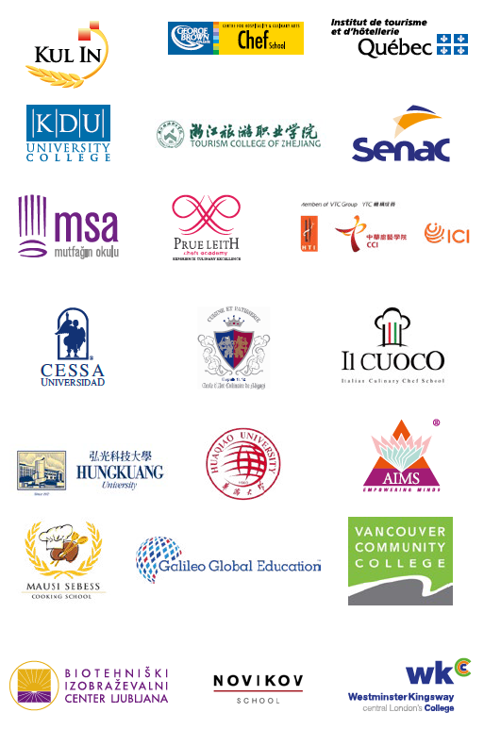
INTERNATIONAL NETWORK
ALMA has created a network of great educational centres all over the world.
With these renowned schools ALMA organizes courses of Italian Cuisine, structured on periods of study and practical training in Italy during in-school periods and traineeship periods at the most renowned Italian restaurants.
PARTNER SCHOOLS
20
INTERNATIONAL
AGENCIES
25

Slide 14
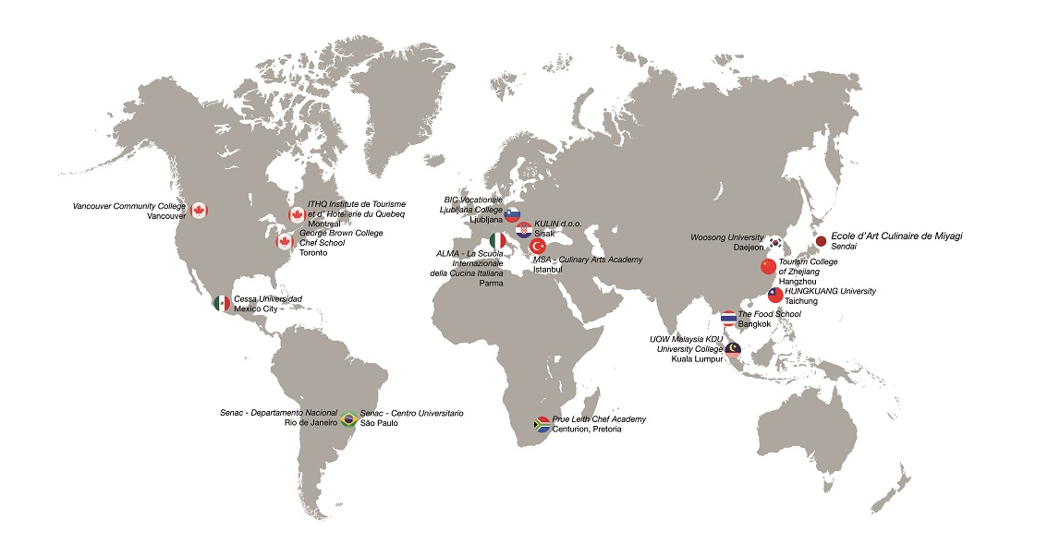
INTERNATIONAL NETWORK

Slide 15
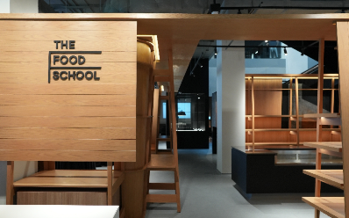
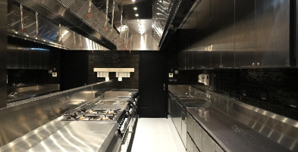
THE FOOD SCHOOL, BANGKOK
ALMA opens its first foreign branch in Bangkok, within the exclusive The Food School, an ambitious international project of Dusit International, one of Thailand’s leading hotel and real estate development companies, that involves also Dusit Thani College and Japan’s renowned Tsuji Culinary Institute.
Central to The Food School’s offerings are long course modules in Thai cooking, Japanese cooking, and Italian cooking and baking, as well as short course modules in culinary science and nutrition, artisanal culinary arts, industrial retraining and upgrading; as well as special courses on plant-based food production, sustainable and locally grown products, and international master classes. Besides, it offers unique business incubation services with “Cloud Kitchen” facilities.
Equipped with the latest kitchen equipment, blended learning platforms, and audiovisual presentation technology, The Food School occupies 3,200 square meters of carefully designed space in the new Creative & Startup Village in the Sam Yan district of the Capital.

Slide 16
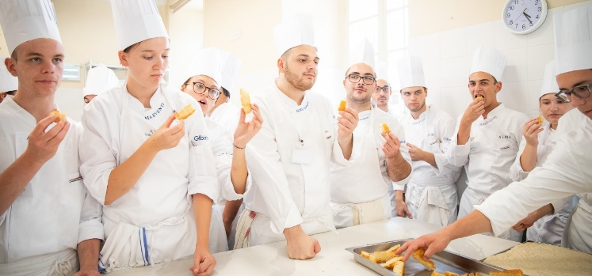
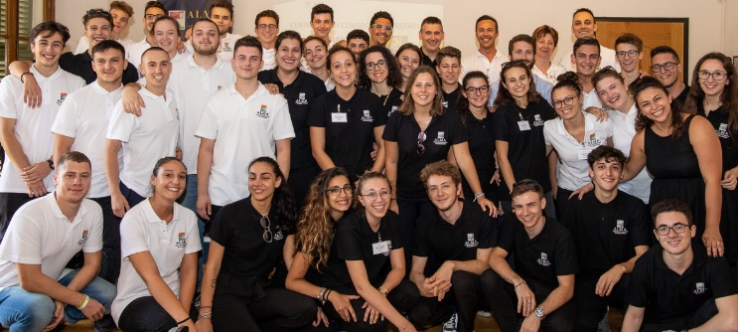
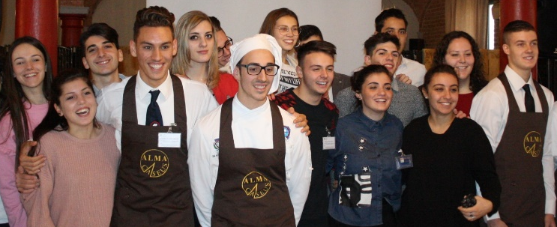
RELATIONS WITH HOSPITALITY INSTITUTES
ALMA promotes intense and stimulating relations with hotel institutes, professional education centres and culinary schools thus creating tailor-made projects for students and teachers.
COOKING QUIZ: Cooking Quiz is the traveling educational competition reserved for students in the 4th grade of Hotelier Institutes throughout Italy with a culinary and dining address, promoted by ELI-PLAN Edizioni, a leading player in publishing in Italy and around the world for more than 30 years, and ALMA.
SUMMER SCHOOL: a training experience intended for graduates from hospitality and catering colleges who have excelled during their programme of studies.
GUIDED VISITS: ALMA welcomes, by appointment, free guided tours of its premises to provide a more direct insight into the School of Italian Culinary Arts.

Slide 17





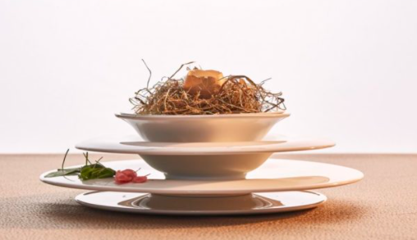
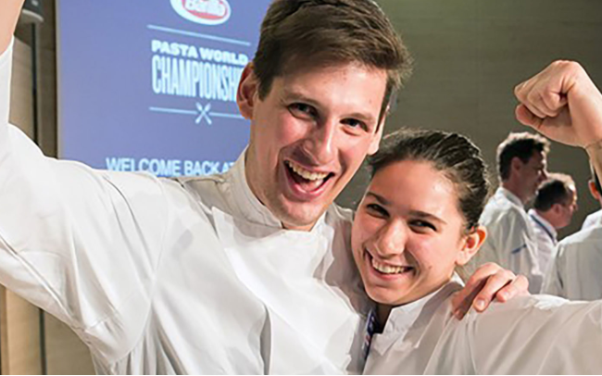
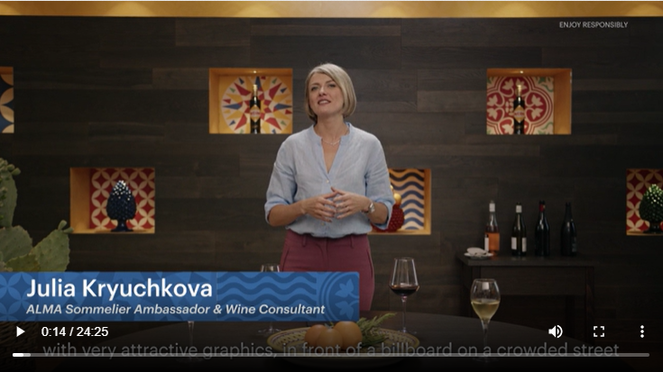
SPECIAL PROJECTS WITH OUR PARTNERS
SAN PELLEGRINO YOUNG CHEF
ARIA
COLLECTION
BARILLA PASTA
WORLD CHAMPIONSHIP
AVERNA DIGITAL PLATFORM
A competition that discovers young and talented chefs around the world by calling together international finalists, all potential best young chefs in the world.
A tableware collection signed Ginori 1735 and ALMA, modular and made with a porcelain with an innovative formulation for the world of "Haute Hôtellerie et Restauration".
A culinary competition between young chefs from all over the world, competing for the title of "Master of Pasta": the object of the challenge is their personal interpretation of a dish featuring pasta.
The digital platform created in collaboration with ALMA and aimed at the catering world, for the relaunch of the Averna brand and the training of operators in the sector.

Slide 18
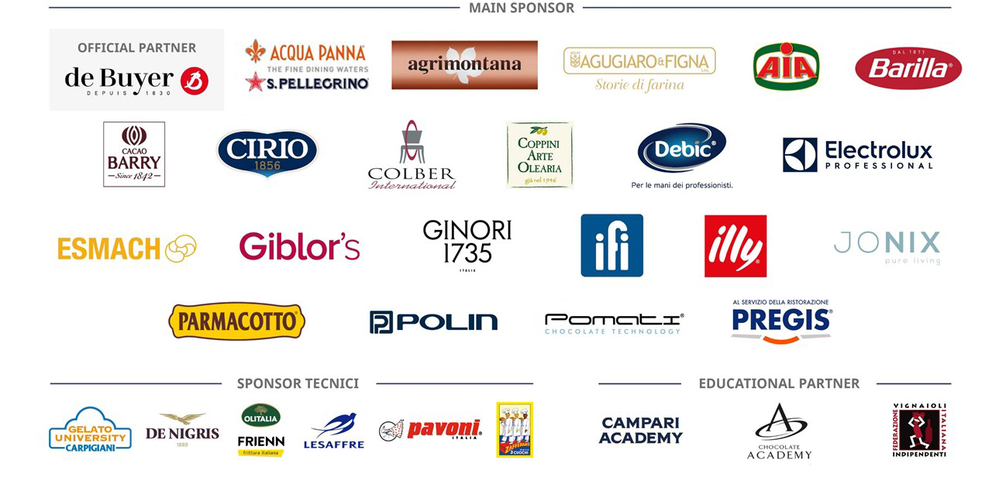

TECHNICAL SPONSOR

Slide 19
Adhering to the ALMA Partner School Network

Slide 20
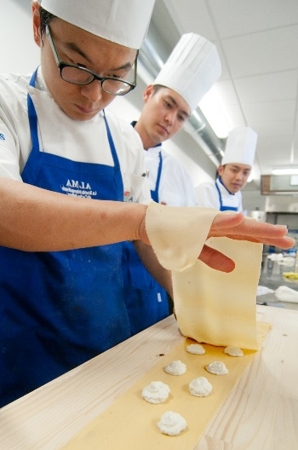
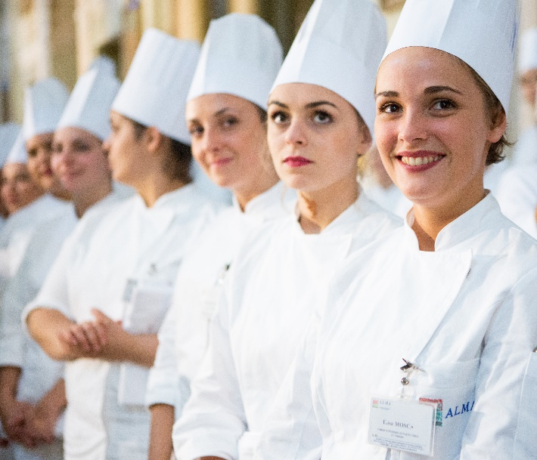
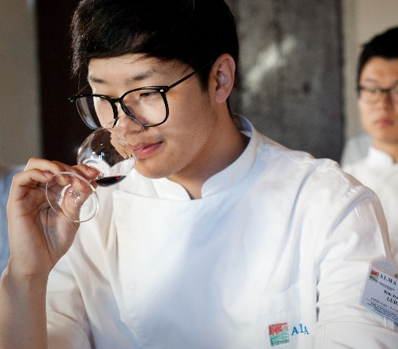
Benefits of being an ALMA partner school
Member of the ALMA International network
Exclusive ALMA international course rates for students
Monetary rewards to invest in promotional activities *per student enrolled
Exchange of knowledge between professors

Slide 21
December 2023: online meeting with ALMA’s External Relations department
Sign the MoU and partership contract found within the comprehensive kit
January 2024:
Start collaboration with ALMA!
Receive the comprehensive kit, including course prices and contracts
The simple process of collaborating with ALMA

Slide 22
LIFE Climate Smart Chefs High Level Course offer to AEHT Member Schools

Slide 23


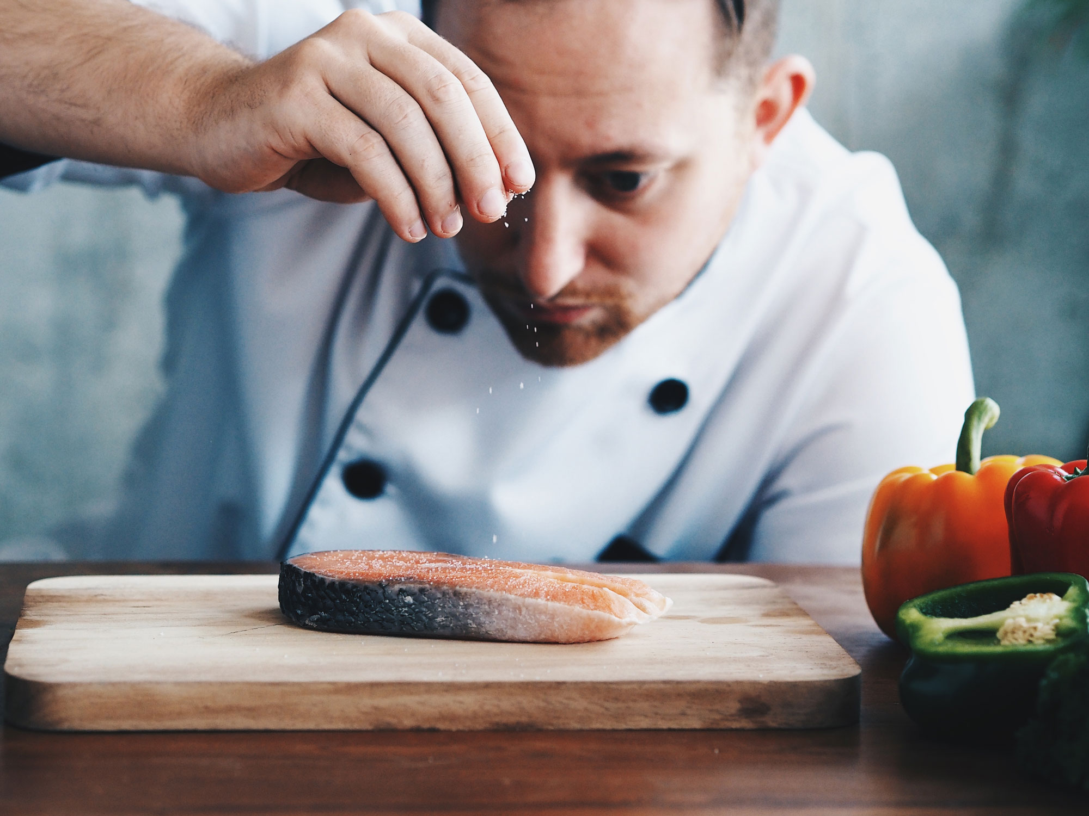






UP TO 37%
of global greenhouse gas emissions
are emitted from farm to fork
70% ON AVERAGE
of freshwater withdrawal is used for agriculture
1/3
of global food production is lost or wasted
LIFE CLIMATE SMART CHEFS is a European project receiving funding from the LIFE Programme of the European Union.
It aims to contribute to the development and implementation of the EU Climate Policy and the Farm to Fork (F2F) Strategy by:
Key project activities include:
1
the implementation of a high-level training course for chefs
the development of a digital tool to design climate smart menus
the creation of an Award dedicated to climate smart chefs and local initiatives promoting sustainable diets
the creation of an EU Network of chef associations
the implementation of the Life Climate Smart Chefs Vision 2030, a strategic paper aimed at providing policy recommendations and supporting EU Climate Policy
actively involving European chefs as promoters of low emission, nutritious and affordable diets
2
3
providing chefs with the knowledge and tools to generate change in recipe design, menu planning and communication with customers, fostering awareness on climate and environmental issues
4
5
promoting a mainstream debate on food as a key factor for climate change mitigation
Project partners:

Slide 24

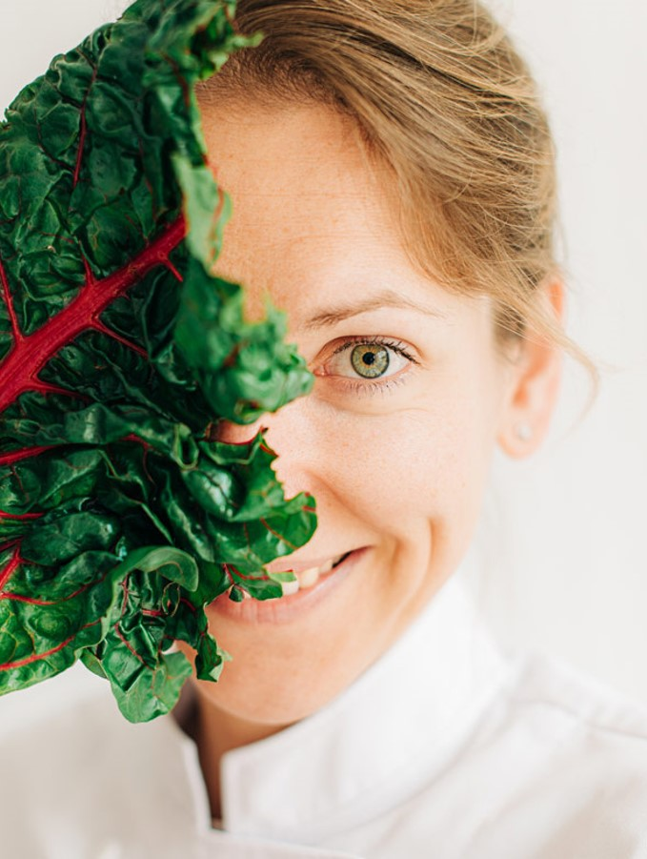
FREE COURSE
For AEHT
Module 1 (6 h, ONLINE)
Introduction to food sustainability and sustainable diets
Module 2 (7 h, ONLINE)
Nordic perspective to food sustainability
Module 3 (8 h, 6 ONLINE + 2 IN-PRESENCE)
Technology for food: Climate Smart Chefs Took + Lab
Module 4 (9 h, 5 ONLINE + 4 IN-PRESENCE)
Module 5 (6h, IN-PRESENCE)
Sustainability and the Mediterranean Diets
29/01/2024 – 27/02/2024
04/03/2024 – 05/03/2024
Project partners:

