Slide 1
EDUCATION NETWORK
W O R L C H E F S PROGRAMS

Slide 2
WHAT IS WORLDCHEFS
The World Association of Chefs Societies (Worldchefs) is a global network of chefs associations founded in October 1928 at the Sorbonne in Paris. Today, this global body has more than 110 official member chefs associations that represent millions of professionals
worldwide.

Slide 3
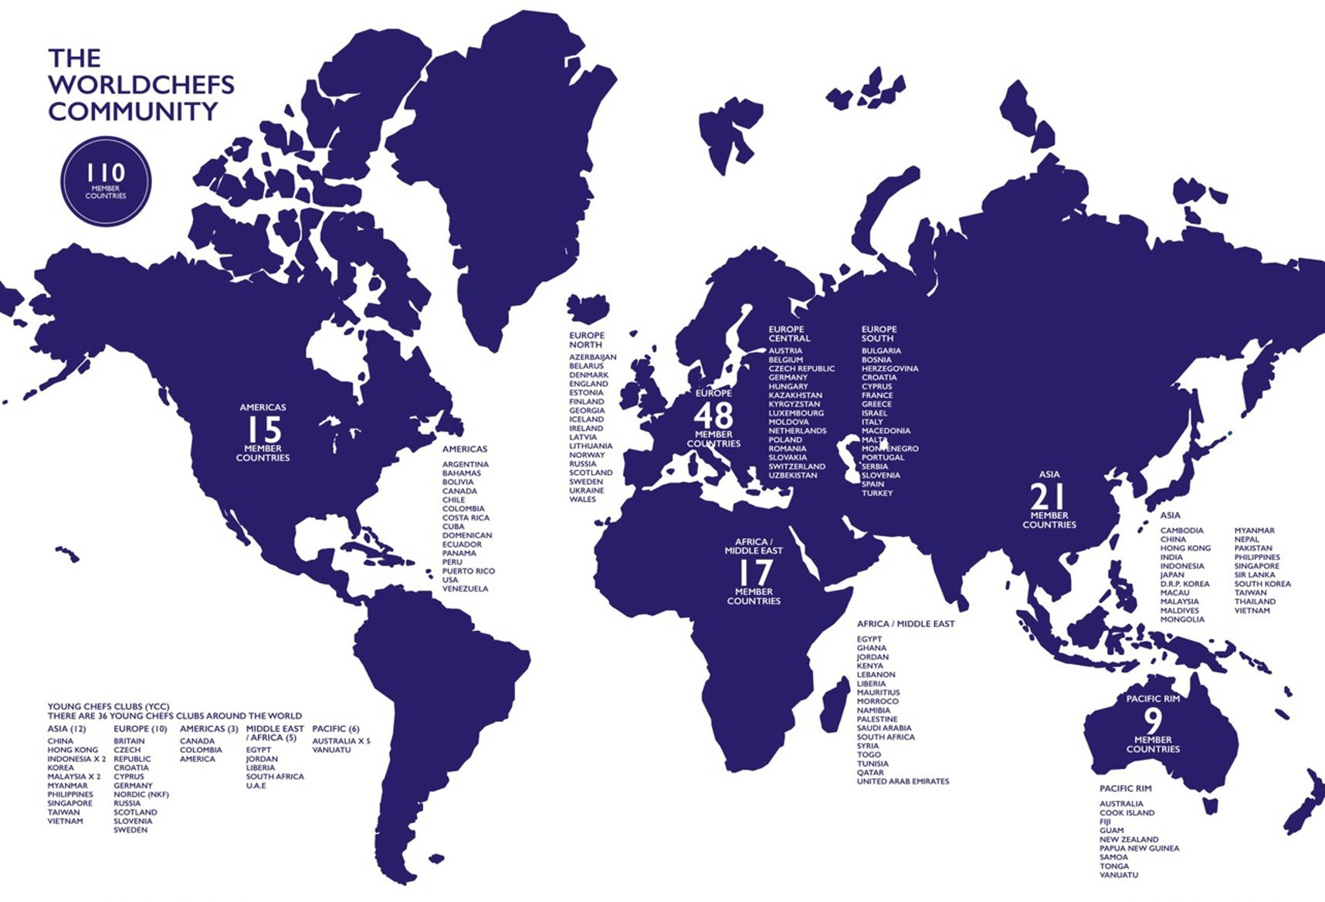

Slide 4
WORLDCHEFS PILLARS

Slide 5
WORLDCHEFS RECOGNIZED SCHOOLS
GLOBAL RECOGNITION LABEL OF EXCELLENCE PEER-BASED NETWORK LEARNING COMMUNITY
INTERNATIONAL BENCHMARKING
L E A R N M O R E : W O R L D C H E F S . O R G / R E C O G N I Z E D - S C H O O L

Slide 6
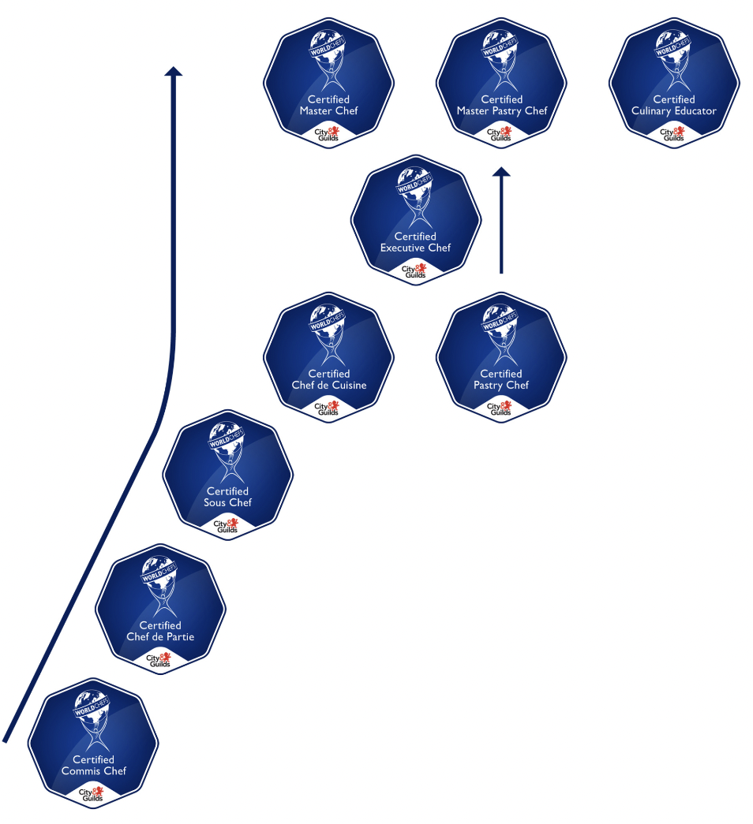
GLOBAL CULINARY CERTIFICATION
THE WORLD’S ONLY GLOBAL CULINARY CERTIFICATION.
Recognises the skills and experience of culinary professionals working in the industry

Slide 7
WORLDCHEFS CERTIFICATION CENTRE
BECOME AN APPROVED CERTIFICATION CENTER OF GLOBAL CULINARY CERTIFICATION
A GLOBAL RECOGNITION
SHOWCASE PROFESSIONAL EXCELLENCE
INCREASE MOBILITY AND EMPLOYABILITY OF GRADUATES
ATTRACT THE BEST TALENT
L E A R N M O R E : W O R L D C H E F S . O R G / G L O B A L - H O S P I T A L I T Y - C E R T I F I C A T I O N
Notes:
CULINARY SCHOOLS – PIONEER A GLOBAL FUTURE
Attract more students
Attract students by offering your graduates the tools to help them become internationally mobile, and access a global job pool.
Take your culinary program global
Get your program benchmarked against the global industry standard. Give your students the chance to get qualified where you are, and everywhere else.
Give your students a head start
By fast-tracking your program to the Worldchefs Global Culinary Certification, you can offer your students the chance to earn two certificates at once, and give them a jumpstart on their career.

Slide 8
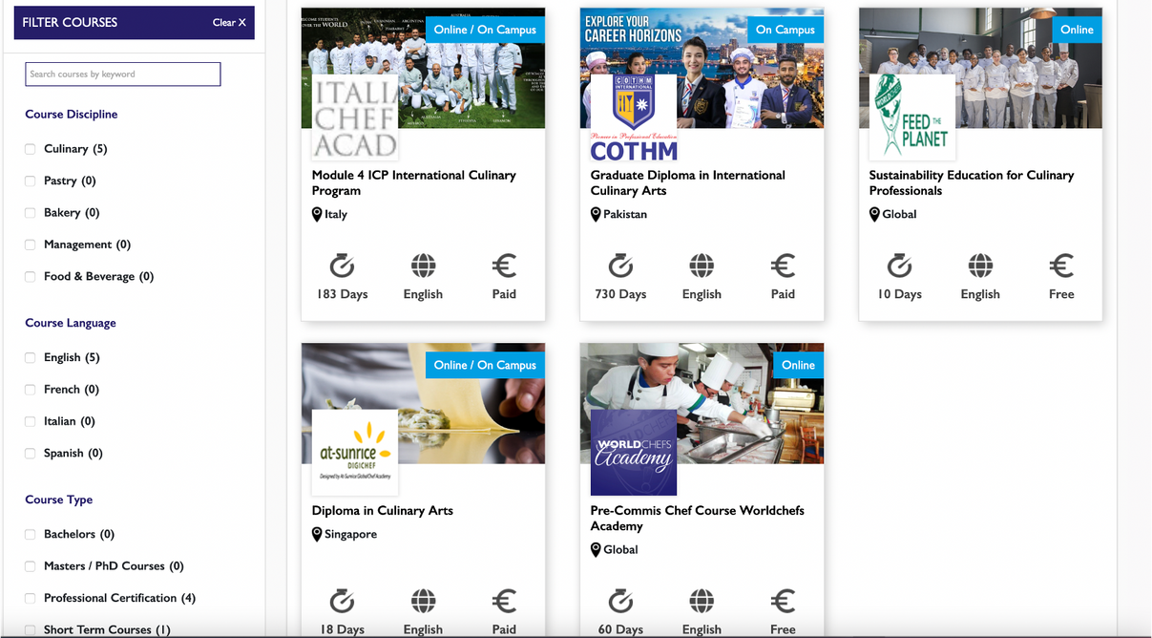
WORLDCHEFS APPROVED COURSES
A COURSE CATALOG OF APPROVED TRAINING PROGRAMS WORLDWIDE.
L E A R N M O R E : W O R L D C H E F S . O R G / A P P R O V E D - C O U R S E S

Slide 9
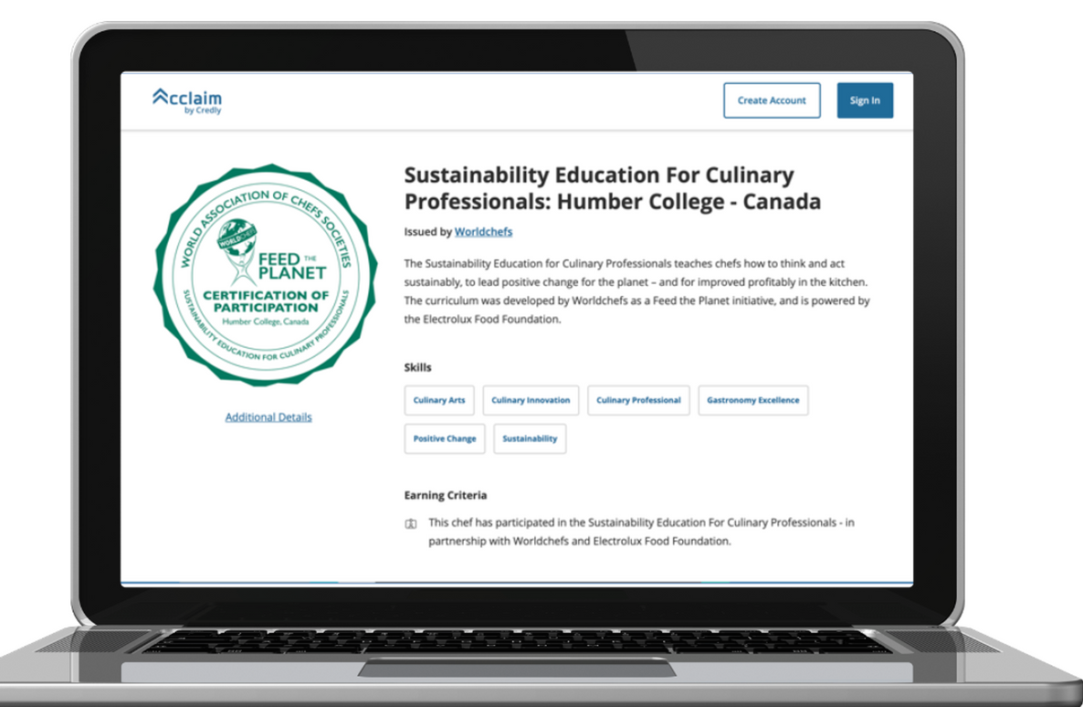
ACCESS WORLDCHEFS CREDENTIALS
UNLOCK A POWERFUL MARKETING TOOL
L E A R N M O R E : W O R L D C H E F S . O R G / W O R L D C H E F S - D I G I T A L - C R E D E N T I A L S

Slide 10
WORLDCHEFS COMMUNITY
Gateway to +2 million hospitality professionals Worldwide
+100
ASSOCIATIONS
Listing of +35,000 jobs worldwide
Personal profiles, visible, searchable and followable on the global network
+150
SCHOOLS
+50K
MEMBERS
Access to +6,000 employers globally
Library of industry insists, career advice, and tips from industry experts
L E A R N M O R E : W O R L D C H E F S . O R G / L O G I N

Slide 11
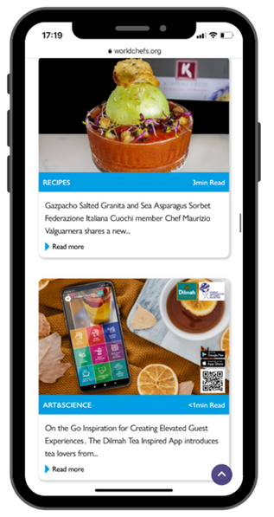
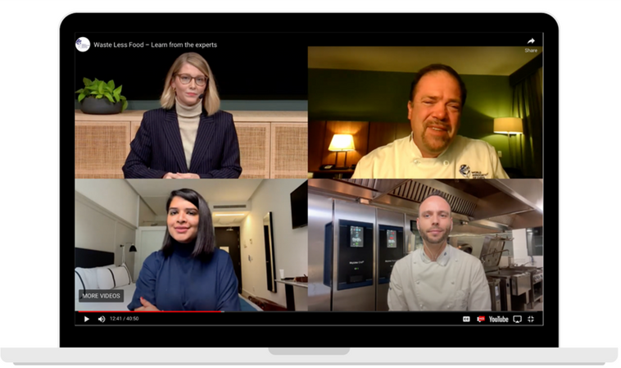
GET FEATURED ON WORLDCHEFS CHANNELS
PUBLISH/CREATE CONTENT WITH WORLDCHEFS TO BRING YOUR BRAND AROUND THE WORLD.
World on a Plate Podcast
E-Events: Webinar/Webcast/Panels
Digital Content: News, Blog, Social
L E A R N M O R E : W O R L D C H E F S . O R G / P O D C A S T S

Slide 12
messaging reached
11,240,000
people in 2022
P E R F O R M A N C E S U M M A R Y | R E A C H

Slide 13
WORLDCHEFS ACADEMY
FREE ONLINE LEARNING FOR CULINARY FOUNDATIONS & SUSTAINABILITY EDUCATION
For us
at
Worldchefs,
it is
important
to give aspiring
chefs the foundation for a proper learning system that is available to everyone all over the world.
Thomas A. Gugler, Worldchefs President
L E A R N M O R E : W O R L D C H E F S A C A D E M Y . C O M

Slide 14
WORLDCHEFS CONGRESS & EXPO
L E A R N M O R E : W O R L D C H E F S C O N G R E S S . O R G

Slide 15
FOR PEOPLE AND THE PLANET
SUSTAINABILITY EDUCATION FOR CULINARY PROFESSIONALS LIKE A CHEF: CULINARY EMPLOYMENT PROGRAM
FOOD HEROES CHALLENGE FOOD WASTE CHALLENGE
WORLD CHEFS WITHOUT BORDERS INTERNATIONAL CHEFS DAY
Join us to leverage the influence of our global network of culinary professionals to drive sustainable change.
We educate, empower, and mobilize communities in the professional kitchen and at home.
ACCESS - COLLABORATE - ENGAGE

Slide 16
SUSTAINABILITY EDUCATION FOR CULINARY PROFESSIONALS
8
LESSONS
5
LANGUAGES
10,000
TRAINED
L E A R N M O R E : W O R L D C H E F S A C A D E M Y . C O M

Slide 17
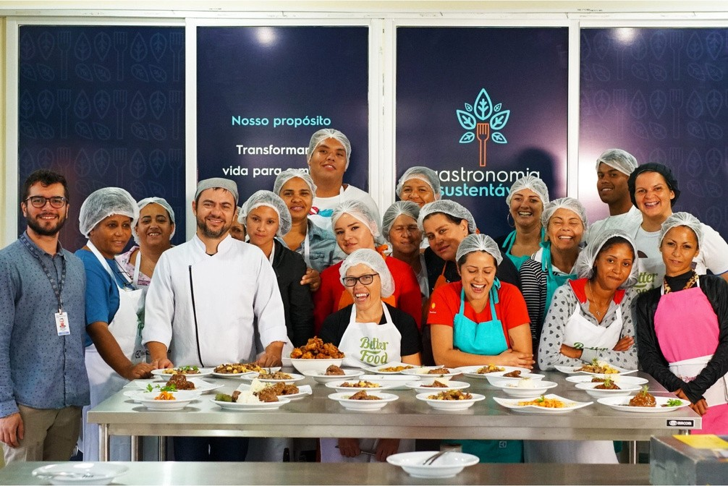
LIKE A CHEF: CULINARY EMPLOYMENT PROGRAM
SUPPORT THE UNDERPRIVILEGED THROUGH FREE PROFESSIONAL CULINARY TRAINING.
8
TRAINING CENTERS
Brazil, Russia, Ukraine, Poland,
Sweden, France, Egypt
1,000
LIVES CHANGED
L E A R N M O R E : F E E D T H E P L A N E T . W O R L D C H E F S . O R G / L I K E - A - C H E F /

Slide 18
FOOD HEROES CHALLENGE
INSPIRE THE NEXT GENERATION TO BECOME FOOD CHAMPIONS!
90,000
FOOD HEROES TRAINED
L E A R N M O R E : F E E D T H E P L A N E T . W O R L D C H E F S . O R G / F O O D H E R O E S C H A L L E N G E /

Slide 19
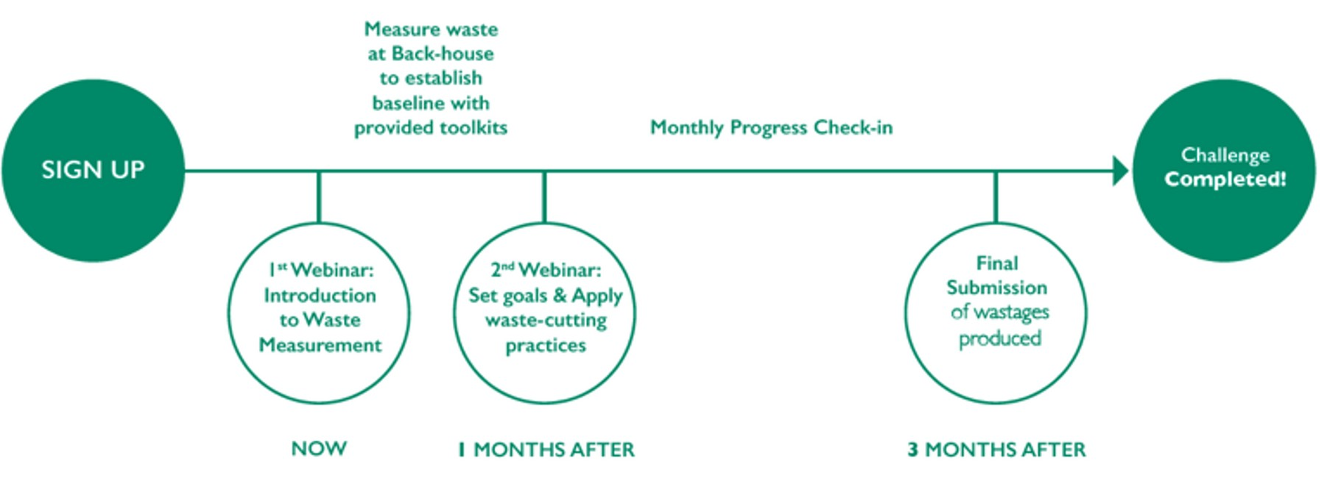
FOOD WASTE CHALLENGE
LEARN HOW TO REDUCE FOOD WASTE IN THE KITCHEN
L E A R N M O R E : F E E D T H E P L A N E T . W O R L D C H E F S . O R G / F W C

Slide 20
THANK YOU
V I S I T A N D S H A R E W I T H U S
L E A R N M O R E : W O R L D C H E F S . O R G

